Slide 1
Qubit Placement to Minimize Communication Overhead in 2D Quantum Architectures
Alireza Shafaei, Mehdi Saeedi, Massoud Pedram
Department of Electrical Engineering
University of Southern California
http://atrak.usc.edu/
Supported by the IARPA Quantum Computer Science Program

Slide 2
Outline
Introduction
Quantum Computing Technologies
Geometric Constraints
Nearest Neighbor Architectures
Proposed Solution
MIP-based Qubit Placement
Force-directed Qubit Placement
Results
Conclusion

Slide 3
Quantum Computing
Motivation: Faster Algorithms
Shor’s factoring algorithm (Superpolynomial)
Grover’s search algorithm (Polynomial)
Quantum walk on binary welded trees (Superpolynomial)
Pell's equation (Superpolynomial)
Formula evaluation (Polynomial)
Representation
http://math.nist.gov/quantum/zoo/
Quantum
Algorithm
Quantum
Circuit
Physical
Realization
(PMD)
PMD: Physical Machine Description

Slide 4
Quantum Circuits
Qubits
Data is carried by quantum bits or qubits
Physical objects are ions, photons, etc.
Quantum Gates
Single-qubit: H (Hadamard), X (NOT)
Two-qubit: CNOT (Controlled NOT), SWAP
Quantum Circuit
H
X
q₀
q₀
q₁
q₁ $⊕$ q₀
q₀
q₁
q₀
X
q₁
q₀
q₁
q₂
q₃

Slide 5
Quantum PMDs
Move-based PMDs
Explicit move instruction
There are routing channels for qubit routing
Examples: Ion-Trap, Photonics, Neutral Atoms
SWAP-based PMDs
No move instruction
There are no routing channels
Qubit routing via SWAP gate insertion
Examples: Quantum Dot, Superconducting
Focus of this presentation is on SWAP-based PMDs

Slide 6
Geometric Constraints
Limited Interaction Distance
Adjacent qubits can be involved in a two-qubit gate
Nearest neighbor architectures
Route distant qubits to make them adjacent
Move-based: MOVE instruction
SWAP-based: insert SWAP gates
1
2
3
2
3
1
1
1
2
3
4
1
4

Slide 7
SWAP-based PMDs
SWAP insertion
Objective
Ensure that all two-qubit gates perform local operations (on adjacent qubits)
Side effects
More gates, and hence more area
Higher logic depth, and thus higher latency and higher error rate
Minimize the number of SWAP gates by placing frequently interacting qubits as close as possible on the fabric
This paper: MIP-based qubit placement
Future work: Force-directed qubit placement (a more scalable solution)
MIP: Mixed Integer Programming

Slide 8
Example on Quantum Dot
Simple qubit placement: place qubits considering only their immediate interactions and ignoring their future interactions
CNOT
X
q₀
X
q₁
CNOT
CNOT
q₂
q₃
q₄
Two SWAP gates

Slide 9
Example on Quantum Dot (cont’d)
Improved qubit placement: place qubits by considering their future interactions
CNOT
X
q₀
X
q₁
CNOT
CNOT
q₂
q₃
q₄
No SWAP gate

Slide 10
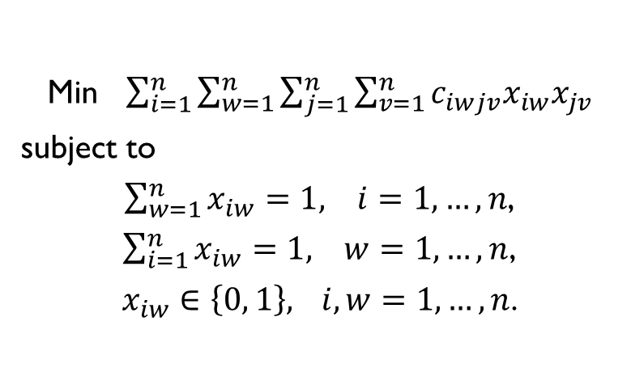
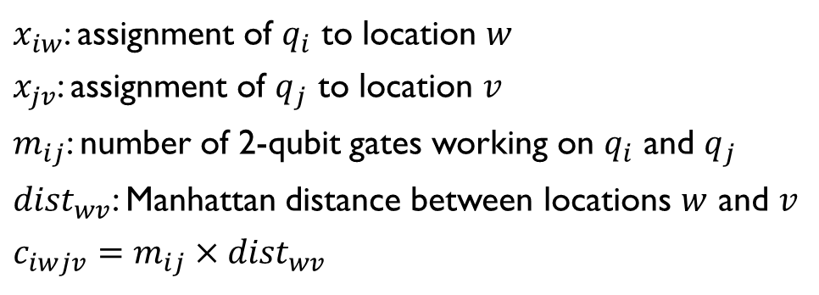
Qubit Placement
Assign each qubit to a location on the 2D grid such that frequently interacting qubits are placed close to one another
$x_{iw}$: assignment of $q_{i}$ to location $w$
$x_{jv}$: assignment of $q_{j}$ to location $v$
$m_{ij}$: number of 2-qubit gates working on $q_{i}$ and $q_{j}$
${dist}_{wv}$: Manhattan distance between locations $w$ and $v$
$$c_{iwjv}=m_{ij}×{dist}_{wv}$$
$$q_{j}$$
$$v$$
$${dist}_{wv}$$
$$q_{i}$$
$$w$$
Min $\sum_{i=1}^{n}{\sum_{w=1}^{n}{\sum_{j=1}^{n}{\sum_{v=1}^{n}{c_{iwjv}x_{iw}x_{jv}}}}}$
subject to
$\sum_{w=1}^{n}{x_{iw}=1, i=1,…, n}$,
$\sum_{i=1}^{n}{x_{iw}=1, w=1,…, n}$,
$x_{iw}∈\left\{0, 1\right\},$ $i,w=1,…, n$.
(1)

Slide 11
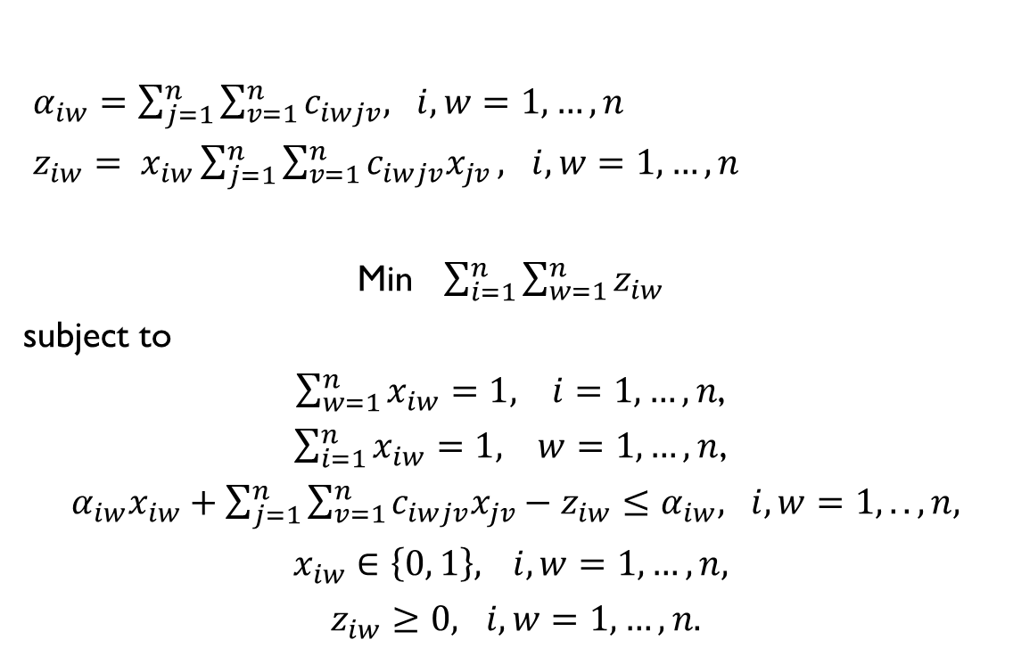
Kaufmann and Broeckx’s Linearization
$α_{iw}=\sum_{j=1}^{n}{\sum_{v=1}^{n}{c_{iwjv}, i,w=1,…,n}}$
$z_{iw}= x_{iw}\sum_{j=1}^{n}{\sum_{v=1}^{n}{c_{iwjv}x_{jv}}}, i,w=1,…,n$
Min $\sum_{i=1}^{n}{\sum_{w=1}^{n}{z_{iw}}}$
subject to
$\sum_{w=1}^{n}{x_{iw}=1, i=1,…, n}$,
$\sum_{i=1}^{n}{x_{iw}=1, w=1,…, n}$,
$α_{iw}x_{iw}+\sum_{j=1}^{n}{\sum_{v=1}^{n}{c_{iwjv}x_{jv}−z_{iw}≤α_{iw}, i,w=1,..,n,}}$
$x_{iw}∈\left\{0, 1\right\},$ $i,w=1,…, n,$
$z_{iw}≥0, i,w=1,…,n.$
(2)
$n^{2}$ binary variables ($x_{iw}$), $n^{2}$ real variables ($z_{iw}$), and $n^{2}+2n$ constraints
R. E. Burkard, E. ela, P. M. Pardalos, and L. S. Pitsoulis. The Quadratic Assignment Problem. Handbook of Combinatorial Optimization, Kluwer Academic Publishers, pp. 241-338, 1998.

Slide 12
MIP Optimization Framework
GUROBI Optimizer 5.5 (http://www.gurobi.com)
Commercial solver with parallel algorithms for large-scale linear, quadratic, and mixed-integer programs (free for academic use)
Uses linear-programming relaxation techniques along with other heuristics in order to quickly solve large-scale MIP problems
Qubit placement (the MIP formulation) does not guarantee that all two-qubit gates become localized; Instead, it ensures the placement of qubits such that the frequently interact qubits are as close as possible to one another
SWAP insertion

Slide 13
SWAP Insertion
7
2
9
3
7
9
3
7
9
3
1
6
2
1
6
1
2
6
4
5
8
4
5
8
4
5
8
CNOT 1, 2
CNOT 5, 8
CNOT 3, 7
CNOT 2, 4
CNOT 6, 8
CNOT 1, 3
CNOT 2, 6
CNOT 1, 2
CNOT 5, 8
CNOT 3, 7
SWAP 2, 7
SWAP 2, 3
CNOT 2, 4
CNOT 6, 8
CNOT 1, 3
CNOT 2, 6
CNOT 1, 2
CNOT 5, 8
CNOT 3, 7
SWAP 2, 7
SWAP 2, 3
CNOT 2, 4
CNOT 6, 8
SWAP 1, 2
CNOT 1, 3
CNOT 2, 6

Slide 14
Solution Improvement (1)
Two qubits may interact with one another at different times
Not satisfactorily captured by a global qubit placer
Solution: Partition the circuit into $k$ sub-circuits ($S_{1} ,⋯{, S}_{k}$)
(1) The placement tool finds initial qubit placements ($P_{j}^{i}$).
(2) A SWAP insertion block generates final qubit placements ($P_{j}^{f}$) by inserting intra-set SWAP gates.
(3) A swapping network inserts inter-set SWAP gates to change the final placement of $Sj$ to the initial placement of $Sj+1$ as generated by the qubit placer

Slide 15
Solution Improvement (2)
In the previous solution, $P_{j}^{f}$is obtained without considering $P_{j+1}^{i}$, for $j≥2$
Large swapping networks
Objective function of (1) only minimizes the intra-set communication distances
Solution: Add a new term to the objective function in order to capture inter-set communication distances
$q_{i,s}$: qubit $i$ in sub-circuit $s$
$x_{iw}^{s}$: assignment of $q_{i,s}$ to location $w$
$x_{jv}^{s}$: assignment of $q_{j,s}$ to location $v$
$m_{ij}^{s}$: number of 2-qubit gates working on $q_{i,s}$ and $q_{j,s}$

Slide 16
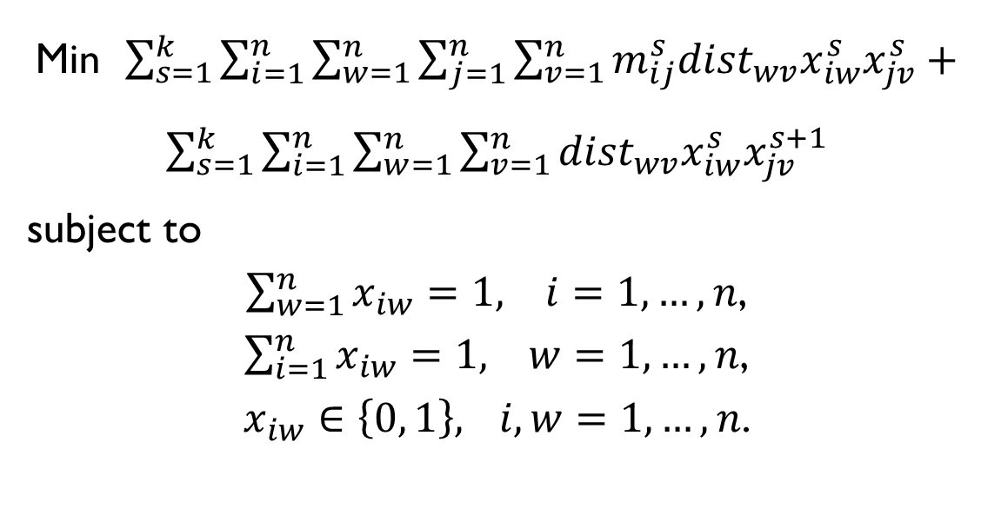
Improved Qubit Placement
Intra-set communication distance
Inter-set communication distance
Min $\sum_{s=1}^{k}{\sum_{i=1}^{n}{\sum_{w=1}^{n}{\sum_{j=1}^{n}{\sum_{v=1}^{n}{{m_{ij}^{s}dist}_{wv}x_{iw}^{s}x_{jv}^{s}}}}}}+\sum_{s=1}^{k}{\sum_{i=1}^{n}{\sum_{w=1}^{n}{\sum_{v=1}^{n}{{dist}_{wv}x_{iw}^{s}x_{jv}^{s+1}}}}}$
subject to
$\sum_{w=1}^{n}{x_{iw}=1, i=1,…, n}$,
$\sum_{i=1}^{n}{x_{iw}=1, w=1,…, n}$,
$x_{iw}∈\left\{0, 1\right\},$ $i,w=1,…, n$.
(3)

Slide 17
Force-directed Qubit Placement
Attractive forces
A force proportional to $m_{ij}^{s}$ between $q_{i,s}$ and $q_{j,s}$.
A (unit) force between between $q_{i,s}$ and $q_{i,s+1}$.
Can be solved by quadratic programming

Slide 18
Results (1)
Our Method
Best 1D
 | # of qubits | # of gates | Grid Size | #SWAPs | #SWAPs | Imp. (%) | Ref.
3_17 | 3 | 13 | 2x2 | 6 | 4 | -50 | [1]
4_49 | 4 | 30 | 2x2 | 13 | 12 | -8 | [1]
4gt10 | 5 | 36 | 3x2 | 16 | 20 | 20 | [1]
4gt11 | 5 | 7 | 2x3 | 2 | 1 | -100 | [1]
4gt12 | 5 | 52 | 3x2 | 19 | 35 | 46 | [1]
4gt13 | 5 | 16 | 3x3 | 2 | 6 | 67 | [1]
4gt4 | 5 | 43 | 2x3 | 17 | 34 | 50 | [1]
4gt5 | 5 | 22 | 3x3 | 8 | 12 | 33 | [1]
4mod5 | 5 | 24 | 2x3 | 11 | 9 | -22 | [1]
4mod7 | 5 | 40 | 3x3 | 13 | 21 | 38 | [1]
aj-e11 | 4 | 59 | 2x3 | 24 | 36 | 33 | [1]
alu | 5 | 31 | 2x3 | 10 | 18 | 44 | [1]
decod24 | 4 | 9 | 2x2 | 3 | 3 | 0 | [1]
ham7 | 7 | 87 | 3x3 | 48 | 68 | 29 | [1]
hwb4 | 4 | 23 | 3x3 | 9 | 10 | 10 | [1]
hwb5 | 5 | 106 | 3x2 | 45 | 63 | 29 | [1]
hwb6 | 6 | 146 | 2x3 | 79 | 118 | 33 | [1]
hwb7 | 7 | 2659 | 3x3 | 1688 | 2228 | 24 | [1]
hwb8 | 8 | 16608 | 3x3 | 11027 | 14361 | 23 | [1]
hwb9 | 9 | 20405 | 4x3 | 15022 | 21166 | 29 | [1]
mod5adder | 6 | 81 | 3x2 | 41 | 51 | 20 | [1]
mod8-10 | 5 | 108 | 3x3 | 45 | 72 | 38 | [1]
rd32 | 4 | 8 | 2x3 | 2 | 2 | 0 | [1]
rd53 | 7 | 78 | 5x2 | 39 | 66 | 41 | [1]
rd73 | 10 | 76 | 4x4 | 37 | 56 | 34 | [1]

Slide 19
Results (2)
Our Method
Best 1D
 | # of qubits | # of gates | Grid Size | #SWAPs | #SWAPs | Imp. (%) | Ref.
sym9 | 10 | 4452 | 4x4 | 2363 | 3415 | 31 | [1]
sys6 | 10 | 62 | 4x4 | 31 | 59 | 47 | [1]
urf1 | 9 | 57770 | 3x3 | 38555 | 44072 | 13 | [1]
urf2 | 8 | 25150 | 2x4 | 16822 | 17670 | 5 | [1]
urf5 | 9 | 51380 | 3x3 | 34406 | 39309 | 12 | [1]
QFT5 | 5 | 10 | 3x2 | 5 | 6 | 17 | [1]
QFT6 | 6 | 15 | 2x3 | 6 | 12 | 50 | [1]
QFT7 | 7 | 21 | 5x2 | 18 | 26 | 31 | [1]
QFT8 | 8 | 28 | 4x2 | 18 | 33 | 45 | [1]
QFT9 | 9 | 36 | 3x3 | 34 | 54 | 37 | [1]
QFT10 | 10 | 45 | 5x3 | 53 | 70 | 24 | [1]
cnt3-5 | 16 | 125 | 3x6 | 69 | 127 | 46 | [2]
cycle10_2 | 12 | 1212 | 3x4 | 839 | 2304 | 64 | [2]
ham15 | 15 | 458 | 5x3 | 328 | 715 | 54 | [2]
plus127mod8192 | 13 | 65455 | 5x4 | 53598 | 151794 | 65 | [2]
plus63mod4096 | 12 | 29019 | 5x3 | 22118 | 61556 | 64 | [2]
plus63mod8192 | 13 | 37101 | 5x3 | 29835 | 82492 | 64 | [2]
rd84 | 15 | 112 | 5x3 | 54 | 148 | 64 | [2]
urf3 | 10 | 132340 | 4x3 | 94017 | 154672 | 39 | [2]
urf6 | 15 | 53700 | 5x3 | 43909 | 88900 | 51 | [2]
Shor3 | 10 | 2076 | 4x3 | 1710 | 1816 | 6 | [3]
Shor4 | 12 | 5002 | 3x6 | 4264 | 4339 | 4 | [3]
Shor5 | 14 | 10265 | 5x4 | 8456 | 10760 | 21 | [3]
Shor6 | 16 | 18885 | 4x6 | 20386 | 20778 | 2 | [3]
 |  |  |  | On average |  | 27

Slide 20
Results (3)
Improvement over best 1D solution

Slide 21
Conclusion
Qubit placement methods for 2D quantum architectures
Directly applicable to Quantum Dot PMD
27% improvement over best 1D results
Future work: force-directed qubit placement
Better results by considering both intra- and inter-set SWAP gates in the optimization problem

Slide 22
References
[1] A. Shafaei, M. Saeedi, and M. Pedram, “Optimization of quantum circuits for interaction distance in linear nearest neighbor architectures,” Design Automation Conference (DAC), 2013.
[2] M. Saeedi, R. Wille, R. Drechsler, “Synthesis of quantum circuits for linear nearest neighbor architectures,” Quantum Information Processing, 10(3):355–377, 2011.
[3] Y. Hirata, M. Nakanishi, S. Yamashita, Y. Nakashima, “An efficient conversion of quantum circuits to a linear nearest neighbor architecture,” Quantum Information & Computation, 11(1–2):0142–0166, 2011.

Slide 23
Thank you!

