Slide 1




Optimization of Quantum Circuits for Interaction Distance in
Linear Nearest Neighbor Architectures
Alireza Shafaei, Mehdi Saeedi, Massoud Pedram
University of Southern California
Department of Electrical Engineering
http://atrak.usc.edu/
Supported by the IARPA Quantum Computer Science

Slide 2
Outline
Quantum Computing
Geometric Constraints
  Linear Nearest Neighbor
Proposed Solution
Results
OUTLINE | 1

Slide 3
Quantum Computing
Motivation: Faster Algorithms
Shor’s factoring algorithm (Superpolynomial)
Grover’s search algorithm (Polynomial)
Quantum walk on binary welded trees (Superpolynomial)
Pell's equation (Superpolynomial)
Formula evaluation (Polynomial)
…
Quantum
Algorithm
Quantum
Circuit
Physical
Realization
QUANTUM COMPUTING | 2

Slide 4

Quantum Circuits
Qubits
Data is carried out by quantum bits or qubits
Physical Object: ions, photons, etc.
Quantum Gates
Single-qubit: H (Hadamard gate), X (NOT gate)
Two-qubit: CNOT (Controlled NOT), SWAP
Quantum Circuit
H
X
q₀
q₀
q₁
q₁ $⊕$ q₀
q₀
q₁
q₁
q₀
q₀
X
q₁
q₂
q₃
QUANTUM COMPUTING | 3

Slide 5
Physical Realization
Quantum Computing Technologies
Ion-Trap
Superconducting
Photonics
Neutral Atoms
Quantum Dots
CNOT
X
q₀
X
CNOT
CNOT
q₁
q₂
q₃
q₄
QUANTUM COMPUTING | 4
Notes:
Change this to Quantum Dot!

Slide 6
Geometric Constraints
Limited Interaction Distance
Nearest Neighbor Architectures
  Adjacent qubits can be involved in a two-qubit gate
Distant Qubits
Route qubits to make them adjacent
Move-based
  Move instruction, routing channel
SWAP-based
  Insert SWAP gates
1
2
3
2
3
1
1
1
2
3
4
1
4
Objective: Minimize the # of SWAP gates
GEOMETRIC CONSTRAINTS | 5

Slide 7
Limited Interaction Distance
Non-local circuit
Local circuit
How to create a local circuit?
Insert SWAP gates
Change the qubit ordering (i.e., qubit placement) → SWAP-free!
GEOMETRIC CONSTRAINTS | 6

Slide 8
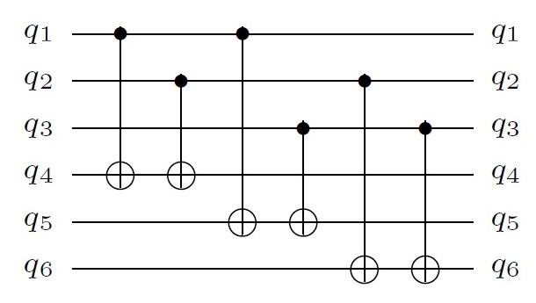
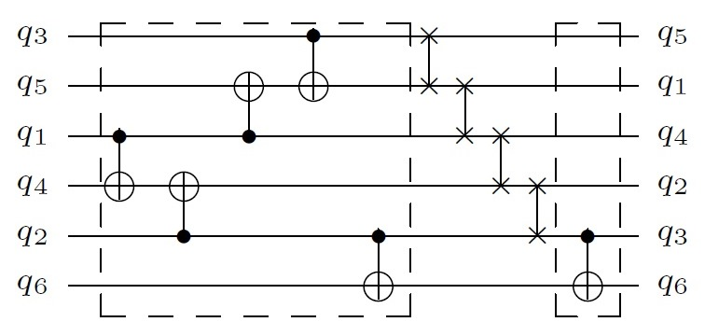
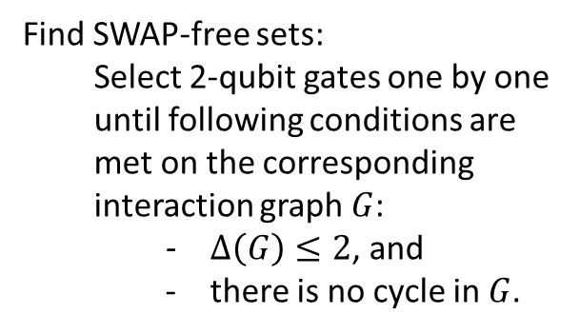
Proposed Solution
3
5
Interaction Graph
1
4
2
Inter-set SWAP gates
Find SWAP-free sets:
  Select 2-qubit gates one by one until following conditions are met on the corresponding interaction graph $G$:
    $Δ\left(G\right)≤2$, and
    there is no cycle in $G$.
6
SWAP-free Set
PROPOSED SOLUTION | 7

Slide 9
Proposed Solution
Qubit placements dynamically change
  Look-ahead search in order to find the placement that minimizes the number of inter-set SWAP gates
Future work
  Force-directed placement
PROPOSED SOLUTION | 8

Slide 10
Results
Number of SWAP gates
Circuit | n | [18] | Ours | %
3_17_13 | 3 | 6 | 4 | 33
4_49_17 | 4 | 20 | 12 | 40
4gt10-v1_81 | 5 | 30 | 20 | 33
4gt11_84 | 5 | 3 | 1 | 67
4gt12-v1_89 | 5 | 35 | 35 | 0
4gt13-v1_93 | 5 | 11 | 6 | 45
4gt4-v0_80 | 5 | 34 | 34 | 0
4gt5_75 | 5 | 17 | 12 | 29
4mod5-v1_23 | 5 | 16 | 9 | 44
4mod7-v0_95 | 5 | 28 | 21 | 25
aj-e11_165 | 4 | 39 | 36 | 8
alu-v4_36 | 5 | 23 | 18 | 22
decod24-v3_46 | 4 | 4 | 3 | 25
ham7_104 | 7 | 84 | 68 | 19
hwb4_52 | 4 | 14 | 10 | 29
hwb5_55 | 5 | 79 | 63 | 20
hwb6_58 | 6 | 136 | 118 | 13
hwb7_62 | 7 | 3660 | 2128 | 42
Circuit | n | [18] | Ours | %
hwb8_118 | 8 | 24541 | 14361 | 41
hwb9_123 | 9 | 36837 | 21166 | 43
mod5adder_128 | 6 | 85 | 51 | 40
mod8-10_177 | 5 | 77 | 72 | 6
rd32-v0_67 | 4 | 2 | 2 | 0
rd53_135 | 7 | 76 | 66 | 13
rd73_140 | 10 | 62 | 56 | 10
sym9_148 | 10 | 5480 | 3415 | 38
sys6-v0_144 | 10 | 62 | 59 | 5
urf1_149 | 9 | 60235 | 44072 | 27
urf2_152 | 8 | 25502 | 17670 | 31
urf5_158 | 9 | 52440 | 39309 | 25
QFT5 | 5 | 12 | 6 | 50
QFT6 | 6 | 22 | 12 | 45
QFT7 | 7 | 39 | 26 | 33
QFT8 | 8 | 60 | 33 | 45
QFT9 | 9 | 87 | 54 | 38
QFT10 | 10 | 123 | 70 | 43
[18] M. Saeedi, R. Wille, and R. Drechsler, “Synthesis of quantum circuits for linear nearest neighbor architectures,” QIP, 10 (3): 355-377, 2011.
RESULTS | 9

Slide 11
Results
28% on average improvement
[18] M. Saeedi, R. Wille, and R. Drechsler, “Synthesis of quantum circuits for linear nearest neighbor architectures,” QIP, 10 (3): 355-377, 2011.
RESULTS | 10

Slide 12
Thanks!

