Slide 1
Reversible Logic Synthesis of k-Input, m-Output Lookup Tables
Alireza Shafaei, Mehdi Saeedi, Massoud Pedram
University of Southern California
Department of Electrical Engineering
Presented by Yanzhi Wang
Supported by the IARPA
Quantum Computer Science
http://atrak.usc.edu/

Slide 2
Outline
Introduction
Lookup Tables (LUT)
Quantum Walk on Binary Welded Tree
Related Work
Proposed Synthesis Algorithm
Simulation Results
Conclusion

Slide 3
Quantum Circuits
Data is carried out by quantum bits or qubits
Quantum gates
Unitary matrix $U$ ($UU^{†}=I$)
Reversible
Multiple-Control Toffoli (MCT) gate
Negative Control
Positive Control
x
x
y
y
Control lines remain unchanged
z
z
w’ if (x=0 & y=1 & z=1)
w otherwise
w
w_{o}
Target line
$$w_{o}=w⊕x^{′}yz$$
Notes:
In quantum circuits, data is carried out by quantum bits, or qubits. Qubits interact with each other through quantum gates. Any Unitary matrix can act as a quantum gate. (A matrix U is unitary if U times U dagger is equal to Identity matrix, where U dagger is the conjugate transpose of U). Quantum gates are reversible, and hence they have equal number of inputs and outputs.
A well-known quantum gate is the Multiple-Control Toffoli (MCT) gate. It has ‘n’ control lines, and one target line. A control line could be ‘positive’ which means if it is ‘1’ then it is considered as ‘active’. For negative control lines, ‘0’ means the control line is active. Now, if all control lines are active, then the target line will flip ( 0 → 1, 1 → 0 ); otherwise, target line remains unchanged ( 0 → 0, 1 → 1 ). For example, the MCT in this slide has 3 control lines (2 positive, 1 negative). If x=0 and y=1 and z=1, then w will flip. So, the MCT operation can be written as ( w XOR x‘.y.z ).

Slide 4
Reversible Logic Synthesis
Quantum algorithms
Quantum part, e.g., Quantum Fourier Transform
Classical part, or Oracles
Reversible synthesis methods
General purpose vs. special purpose synthesis
Automatic synthesis of a specific type of quantum circuits
Quantum walk on binary welded tree
Modular exponentiation circuits
Notes:
Quantum circuits represent a quantum algorithm.
And quantum algorithms are composed of 2 parts:
1. quantum part where qubits can be in superposition or entanglement state.
2. classical part (also known as oracles) where qubits are either 0 or 1. Thus, they can be synthesized by reversible logic methods. The focus of this presentation is also on synthesizing classical parts of quantum algorithms.
To synthesize a reversible circuit, various reversible logic synthesis algorithms have been proposed in recent past. They are mainly targeted to synthesize any given function, and for this reason may not produce ‘good‘ results in some testbenches. Therefore, for specific circuits which are frequently used in quantum circuits we can design a special purpose synthesis algorithm.
In this work, we will propose a synthesis algorithm which has applications in, at least, Modular exponentiation circuits
and quantum walk. Both of them are important applications in quantum computing since they are exponentially faster than their classical counterpart. For the lack of time, we will only review the quantum walk in this presentation.

Slide 5
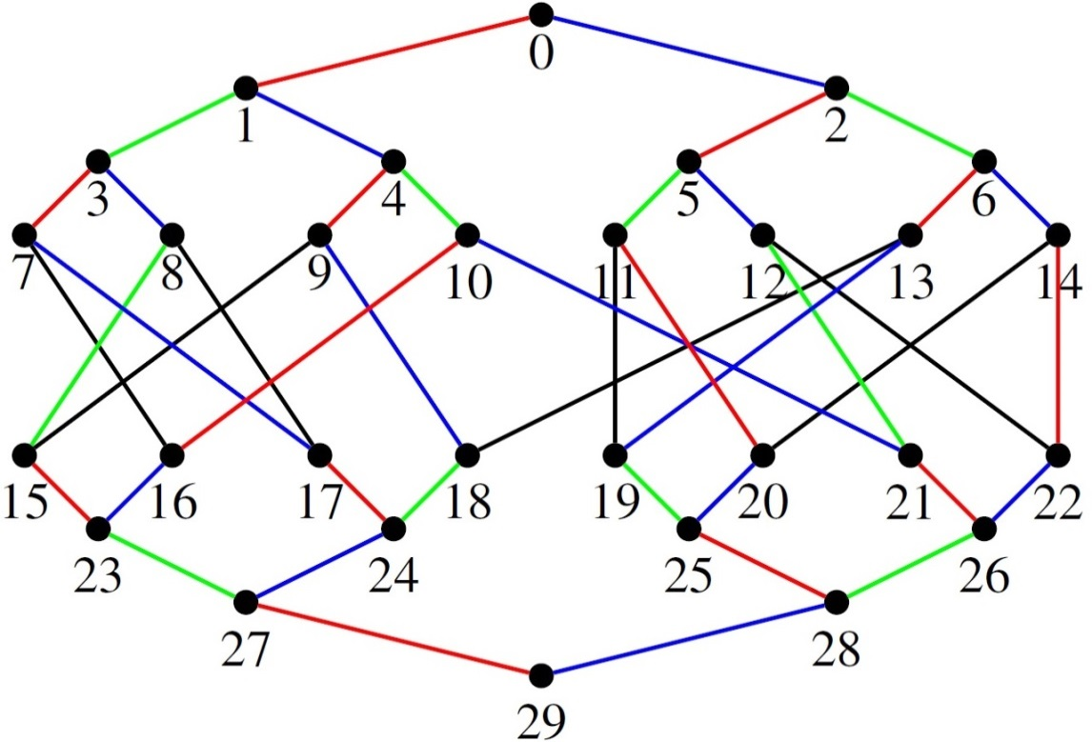
Quantum Walk on Binary Welded Tree
Random movement on a Binary Welded Tree (BWT)
Oracle [1]:
V_{c}(a) = b
Color c
Node a
Node b
a | b
7 | 16
8 | 17
9 | 15
11 | 19
12 | 22
13 | 18
14 | 20
For black edges
[1] A. M. Childs et al., “Exponential algorithmic speedup by a quantum walk,” in Proc. of the 35th Annual ACM Symposium on Theory of Computing, pp. 59–68, 2003.
Notes:
Quantum walk is the quantum analogue of classical random walk. The problem statement is as follows. For a given graph, a probability distribution (which is used in random moves), and a source/destination node, if we start from the source node and take random move at each node of graph, can we reach the destination node?
The authors of [1] have proposed an oracle-based quantum walk on Binary Welded Tree (BWT). They have proven that their quantum walk algorithm is exponentially faster than any classical random walk on BWT. A sample BWT is shown on the right hand side of the slide. It is composed of two binary trees that are welded (attached) together with a random cycle between the leaves. Edges of a BWT are also colored based on graph coloring rules.
The oracle is also shown on top-left of the slide. The oracle takes a node ‘a’, and an edge color ‘c’, and returns node ‘b’ that is connected to node ‘a’ through a ‘c’ color edge. If there is no ‘c’ color edge incident to node ‘a’, then the oracle returns the unique label “invalid”. The oracle for each color can be represented as a table. For instance, the oracle for ‘black’ edges is shown on the bottom-left of the slide.

Slide 6
LUT Synthesis
$(k,m)$ Look-Up Table (LUT)
$k$ read-only inputs
$m$ zero-initialized outputs
LUT realization with MCT gates
e.g., 16 → 7
16 = (10000)₂
x₀
x₀
x | y
16 | 7
x₄
x₄
0
y₀
0
y₀
x₄x₃x₂x₁x₀ | y₄y₃y₂y₁y₀
10000 | 00111
0
0
0
0
0
7 = (00111)₂
0
0
y₄
0
y₄
Notes:
Therefore, the oracle can be represented as a Look-Up Table (LUT). A (k,m)-LUT has ‘k‘ inputs and ‘m‘ outputs. Input qubits should remain unchanged. Outputs are also set to ‘0‘ initially.
Each row of LUT can be realized by an MCT gate. For example, if input is 16 (10000 in binary), the output should be 7 (00111 in binary). Then, the binary representation of the input defines the polarity (positive, negative) of the control lines. Since 16 is equal to 10000, thus the first 4 control lines are negative and the last one is positive. On the other hand, whenever a qubit is 1 in the output, a target line is added. In this example, 7 is represented as 00111 in binary. Since it has 3 ones, so, three target lines are added. Instead of showing three MCT gates which have the same control lines but different targets, we can represent them in a more compact way which is shown on right hand side of the slide.

Slide 7
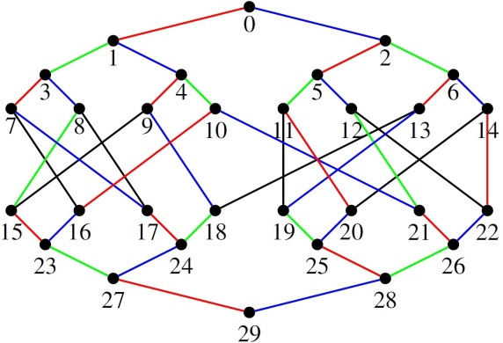
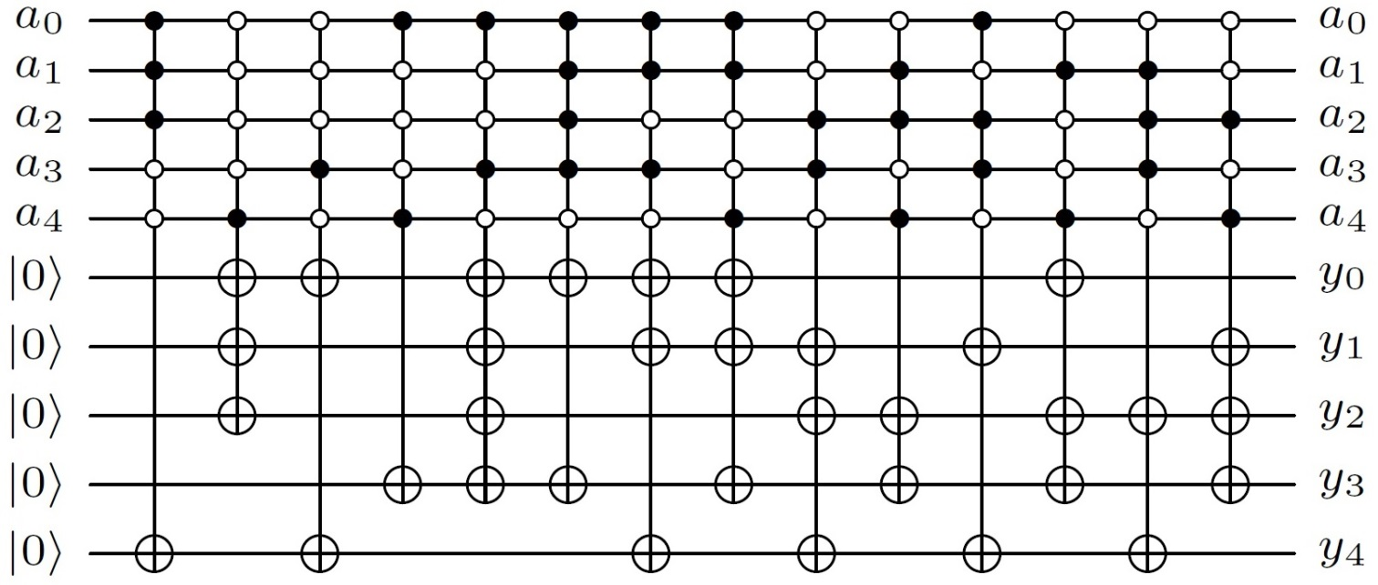
Oracle Implementation
Straightforward implement the oracle for black edges
High cost
a | y
7 | 16
8 | 17
9 | 15
11 | 19
12 | 22
13 | 18
14 | 20
7 → 16
16 → 7
Notes:
Based on the LUT realization that we saw in the previous slide, we can implement the oracle of quantum walk on BWT. For example, the circuit that implements the oracle for black edges is shown in this slide. The synthesis method is very straightforward and fast. However, the synthesis cost is very high!

Slide 8
Related Work
ESOP-based methods [2]
$y_{i}:$ output, $m_{ij}:$ a minterm of $y_{i}$
$y_{i}=m_{i1}⊕m_{i1}⊕⋯⊕m_{in}$
Use an ESOP minimizer to minimize $y_{i}$
General-purpose reversible synthesis methods [3]
Copying input registers into output registers
Apply synthesis algorithm on output register
[2] K. Fazel, M. Thornton, and J. Rice, “ESOP-based Toffoli gate cascade generation,” in PACRIM, pp. 206 –209, Aug. 2007.
[3] M. Saeedi and I. L. Markov, “Synthesis and optimization of reversible circuits - a survey,” ACM Computing Surveys, arXiv:1110.2574, 2013.
Notes:
We can employ the available synthesis algorithms to synthesize an LUT.
One way is to write each output line as the Exclusive OR of the minterms that contribute on that line. As an example, we can write y0 (from the previous slide) as follows:
y0 = m16 XOR m8 XOR m9 XOR m15 XOR m11 XOR m19 XOR m20
Then we can use an ESOP (Exclusive Sum of Product) minimizer to minimize the output line. Afterwards, an ESOP-based synthesis algorithm can be used to realize the circuit.
Another way is to copy input lines into zero-initalized output lines by using CNOT gates. Then we can apply any general-pupose reversible synthesis method to synthesize the output lines.
Please note that ESOP based methods do not change inputs, thus there is no need to first copy them on the output lines.
ESOP based approaches usually lead to expensive MCT gates with many control lines. On the other hand, general purpose methods are general and may not exploit LUT structures for cost reduction.

Slide 9
Proposed Synthesis Algorithm
Cube sharing [4]
To reduce the number of MCT gates
Cofactor sharing
To reduce the number of control lines
Un-computation
To reuse the ancilla line
Look-ahead search
To improve the quality of results
[4] N. M. Nayeem and J. E. Rice, “A shared-cube approach to ESOP-based synthesis of reversible logic,” in Facta universitatis - series: Electronics and Energetics, vol. 24, no. 3, pp. 385–402, Dec. 2011.
Notes:
So, we propose a synthesis algorithm for LUT oracles which works based on the following features:
Cube sharing: This was previously proposed in ESOP-based methods (e.g., [4]). This will reduce the number of MCT gates.
Cofactor sharing: MCT gates that have large number of control lines, have a higher realization cost. So we need a way to reduce the number of control lines in each MCT. In next slides we will see how cofactor sharing can achieve this.
Uncomputation: Consider U as a quantum gate (or even a sequence of quantum gates). If we want to cancel the effect of U on the circuit, we can apply U⁻¹. This is called uncomputation and its main application is ancilla reuse. This feature enables us to add at most one ancilla line to the circuit.
Look-ahead search: For cofactor sharing there are different choices. To improve the quality of results we will employ a look-ahead search that increases the search space.

Slide 10
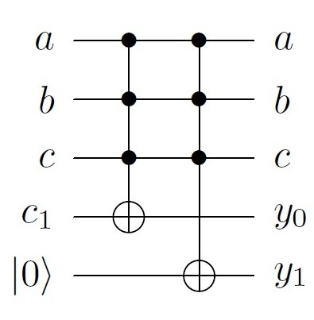
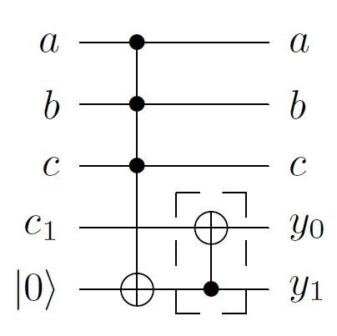
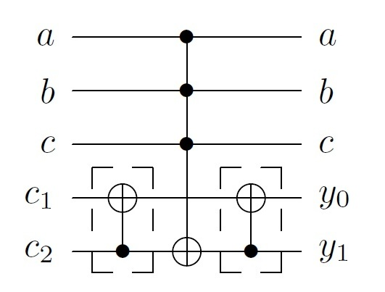
Cube Sharing
Reduces the number of MCT gates
y₀ = c₁+abc
y₁ = abc
y₀ = c₁+abc
y₁ = c₂+abc
No cube sharing
Zero-initialized ancilla available
c₁+c₂
c₂+abc
+: modulo 2 addition
c₁+c₂+c₂+abc
=c₁+abc
Notes:
The idea of cube sharing is presented in this slide. Basically, we do not need one MCT gate for each output line. Instead, we can construct one MCT on one output line, then copy its contents to other output lines.
For example, if y0 = c1 + abc, and y1=abc, then ‘abc‘ is a shared cube. If we don‘t use cube sharing, the circuit has 2 4-input MCT gates which is shown on the left. By cube sharing we can eliminate one MCT gate, and instead use a CNOT gate. Here we were able to construct on a zero-initialized output line, so the copying process was trivial.
However, if there is no zero-initialized output line, like this example: y0=c1+abc, and y1=c2+abc, and suppose that c1 and c2 has been aldready generated on y0 and y1 respectively. In this case, we need two CNOT gates to copy the content of MCT to other output line. The idea is illustrated on the left hand side circuit.
(c1, c2 are a cube, or a sum of cubes).

Slide 11
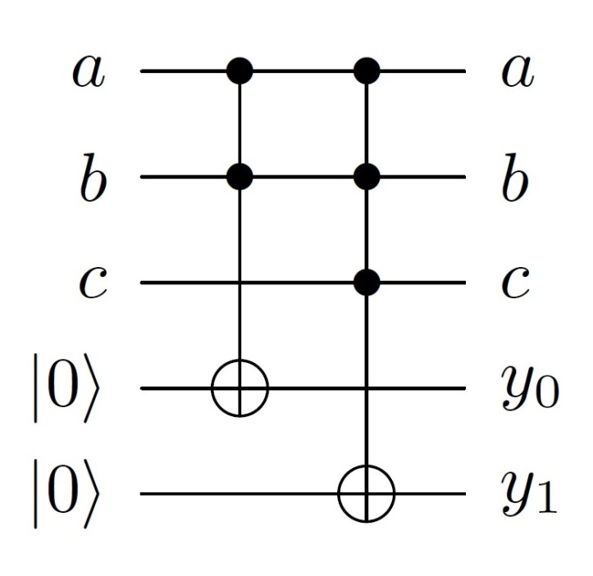
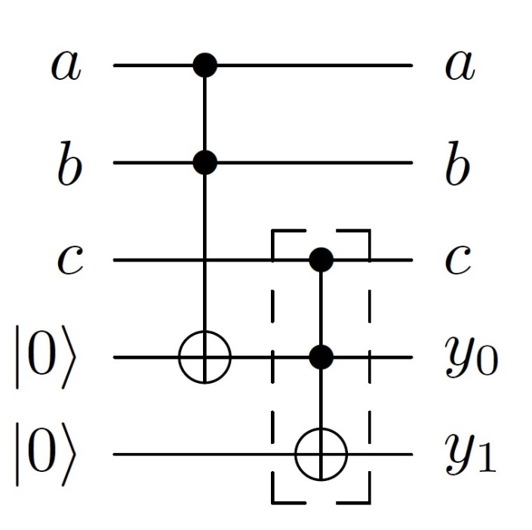
Cofactor Sharing
Reduces the number of control lines
y₀ = ab
y₁ = abc
ab is the shared cofactor, which is also a cube for y₀
Notes:
Now, consider this example: y0=ac, y1=abc. They do not have any shared cubes. However, ‘ab‘ is a shared cofactor. So we can use this feature to reduce the number of control lines in MCT gates.
In this example, ‘ab‘ is first generated on y0 (please look at the circuit on right). Then, it is used to construct ‘ab.c‘ on y1.
In this example, the shared cofactor was also a cube in one of the output lines. (the shared cofactor is ‘ab‘, which is a cube in y0)

Slide 12
Un-computation
Ancilla reuse
y₀ = abc
y₁ = abd
ab is the shared cofactor, but does not appear on neither of the outputs
Zero-initialized ancilla available
Un-computation of ab
Notes:
However, if the shared cofactor is not a cube, then we will use the concept of uncomputation in order to still take advantage of cofactor sharing.
For example, y0=abc, y1=abd. Shared cofactor is ‘ab‘, but it is not a cube in any of the output lines. So, we first add a zero-initialized ancilla line. Then, ‘ab‘ (shared cofactor) is constructed on that ancilla line. Afterwards, we use it to generate ‘ab.c‘ and ‘ab.d‘ on y0 and y1 respectively. Finally we need to uncompute the ancilla line, and hence return its value to ‘0‘. Therefore, we only need one ancilla line for the whole circuit.
Even if we assume that there is no zero-initialized ancilla line, then we can still use the idea of cofactor sharing. The circuit on right shows an example. Here, the copying cost is more expensive.
(In MCT gates, U=U⁻¹, therefore to uncompute an MCT gate we only need to add it one more time)

Slide 13
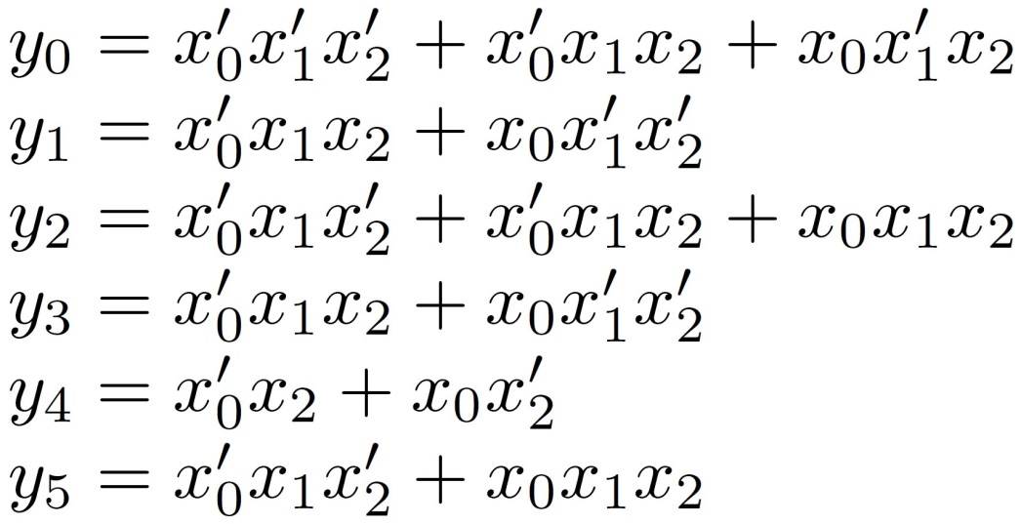
Example
3-input, 6-output LUT
Notes:
Next, we will explain our synthesis algorithm. Consider a 3-input, 6-output LUT with equations shown in this slide.

Slide 14
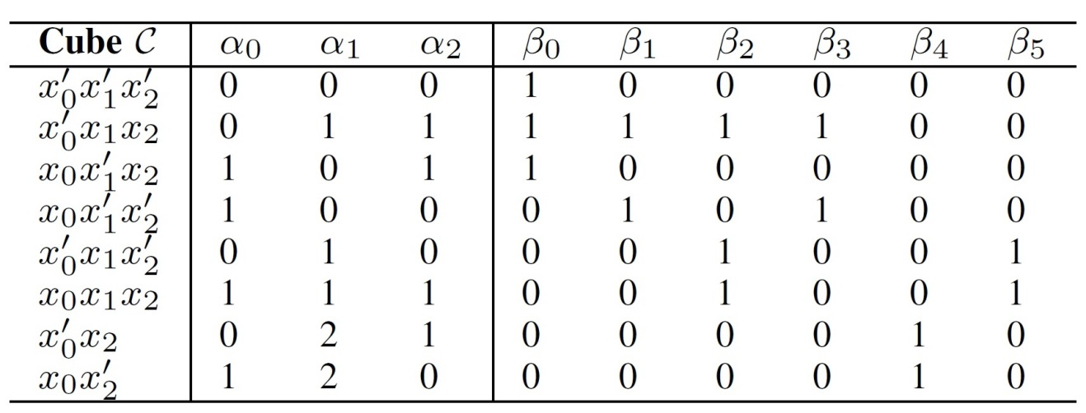
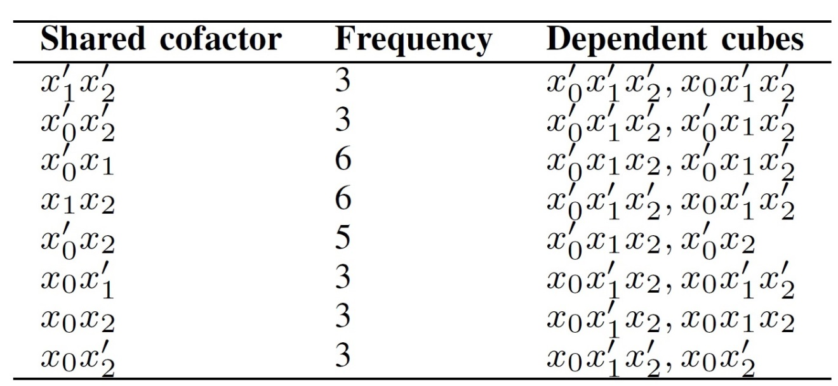
Example: Lists
cube_list
input to the synthesis algorithm
shared_cofactor_list
constructed by pair-wise comparison of cubes
Notes:
The LUT is represented as Sum of Cubes, which is called the cube_list. This is the input to the synthesis algorithm.
xi: input variables (0 < i < k)
yj: output variables (0 j < m)
Then, a cube can be represented as a row vector C[a(0), … , a(k-1), b(0), … , b(m-1)] . In this notation, a(i)=0 if xi appears as complemented, a(i)=1 if xi appears as un-complemented, and a(i)=2 if xi does not exist in the cube. Additionally, b(j)=0 if C is not available in yj, and b(j)=1 if C is available in yj.
Based on the cube_list, we generate all shared cofactors. This is achieved by pairwise comparison of all cubes. For each shared cofactor, we also store the dependent cubes. So, for example, if we construct shared cofactor x1‘.x2‘ then we can use it to construct the following cubes: x0‘.x1‘.x2‘ and x0.x1‘.x2‘

Slide 15
Synthesis
Pick a shared cofactor, implement it along with all its dependent cubes
Which shared cofactor to choose first?
S₁
S₂
S₃
If we choose S₁, then C₁, C₂, and C₃ will be created
C₁
C₂
C₃
C₄
C₅
C₆
S₂
S₃
After removing S₁, C₁, C₂, and C₃, S₂ is no more a shared cofactor
C₄
C₅
C₆
S_{i}: shared cofactors, C_{i}: cubes
Notes:
Now, we have the list of all shared cofactors. To generate the circuit, we should pick a shared cofactor, construct it and then construct all its dependent cubes, and if necessary uncompute the shared cofactor.
However, the question is which shared cofactor should we choose first? The reason this is important is because when we choose a shared cofactor, that could eliminate some other shared cofactors. For example, in this slide you can see three shared cofactors (s1, s2, s3), and their dependent cubes are shown by an edge. C1, C2, and C3 have S1 as a shared cofactor; C2 and C4 have S2 as the shared cofactor, and so on. If w pick S1, it will implement C1, C2, and C3 as well. So, S2, S3 and C4, C5, and C6 remain. However, now S2 can only construct C4 and hence it is no longer a shared cofactor. So, it is eliminated from the shared cofactor list.

Slide 16
Look-ahead Search
Exhaustive search until depth d
Find path p with the lowest cost
Pick the first node (from top) in p as the shared cofactor

Level-0 shared cofactors
look-ahead depth
Remaining shared cofactors at Level-i
Notes:
Therefore, in order to explore the search space effectively, we employ a lookahead search. We construct a tree where the root is an empty node, and all shared cofactors that we initially find are its children (in this figure, they are shown as Level-0 shared cofactors). By choosing each shared cofactor, we first eliminate cofactors that are no longer shared (we explained the concept in the previous slide), then remaing shared cofactors will be children at level-1. We proceed this procedure until depth d. Then, the path which leads to lowest cost is chosen. In that path, we pick the Level-0 shared cofactor (which is the first node from top in that path). This will be our first shared cofactor.
Then, among the remaing shared cofactor, we perform the same lookahead search to choose the second shared cofactor. This search is continued until all shared cofactors are consumed.

Slide 17
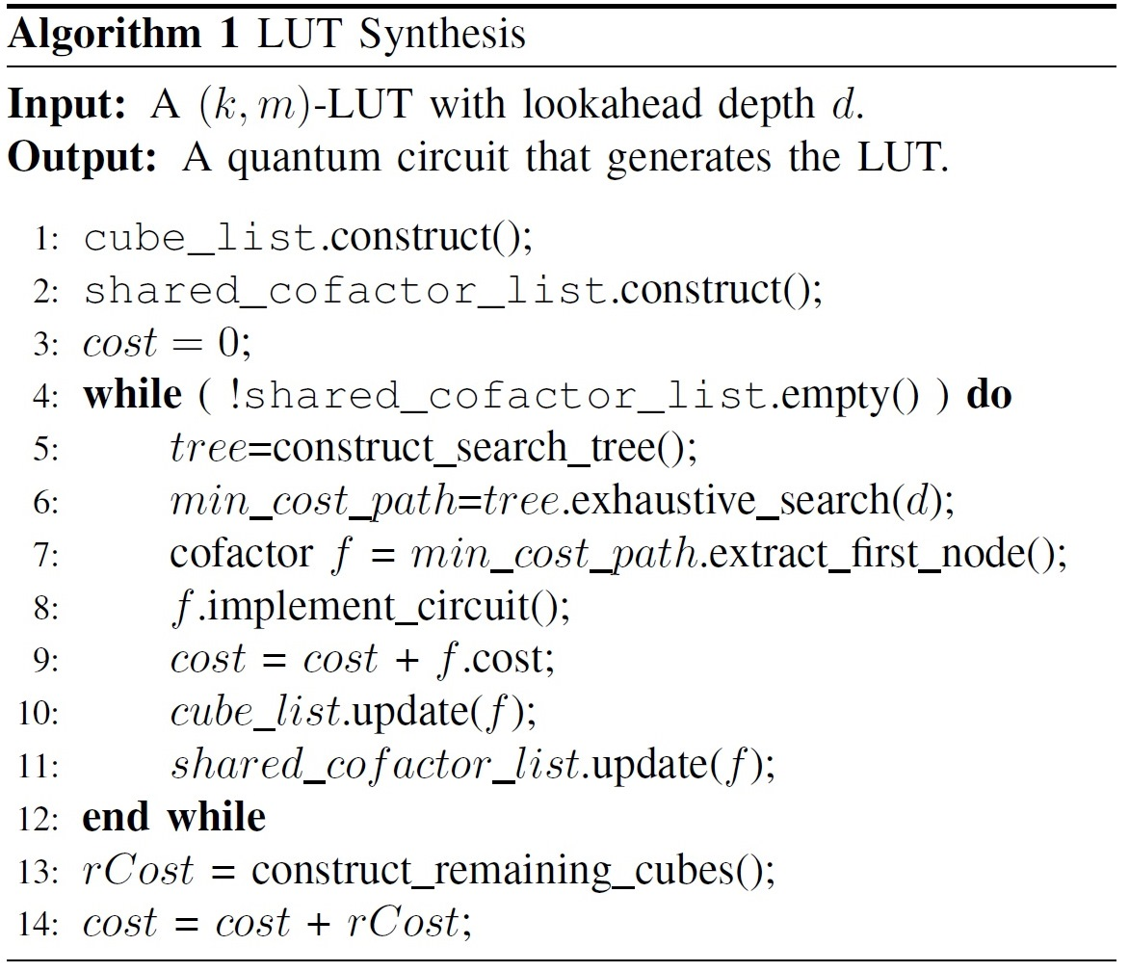
Synthesis Algorithm
look-ahead search
synthesis
Notes:
And finally here is the algorithm.
Line 1 and 2 construct the cube list, and the shared cofactor list.
Line 4 says as long as there is a shared cofactor, do the lookahead search. Lookahead search is done in Lines 5-7.
Lines 8-11, construct the shared cofactor and all its dependent cubes, then update the cost, the cube list, and the shared cofactor list.
The update function for cube_list, removes dependent cubes from the list.
The update function for shared_cofactor_list, removes cofactors that are no longer shared between at least 2 cubes.

Slide 18
Simulation Setup
Implemented in C++
EXORCISM-4 [5] to initially construct a minimized ESOP representation
At most one ancilla in all circuits
3-level of look-ahead (d = 3)
Intel Core i7-2600, 8GB memory
[5] A. Mishchenko and M. Perkowski, “Fast heuristic minimization of exclusive sum-of-products,” in Reed-Muller Workshop, 2001.
Notes:
Simulation setup is summarized here.
EXORCISM-4 is an ESOP minimizer.

Slide 19
Results: MCNC Benchmarks
28% (on average ) improvement over [13]
Runtime from a few seconds to about 5 minutes
[13] N. M. Nayeem and J. E. Rice, “A shared-cube approach to ESOP-based synthesis of reversible logic,” in Facta universitatis - series: Electronics and Energetics, vol. 24, no. 3, pp. 385–402, Dec. 2011.
Notes:
Simulation results for MCNC benshmarks.
Our proposed synthesis algorithm is targeted for LUTs. However, it is also able to produce better results than ESOP-based synthesis methods. On average 28% improvement was obtained compared to [13].

Slide 20
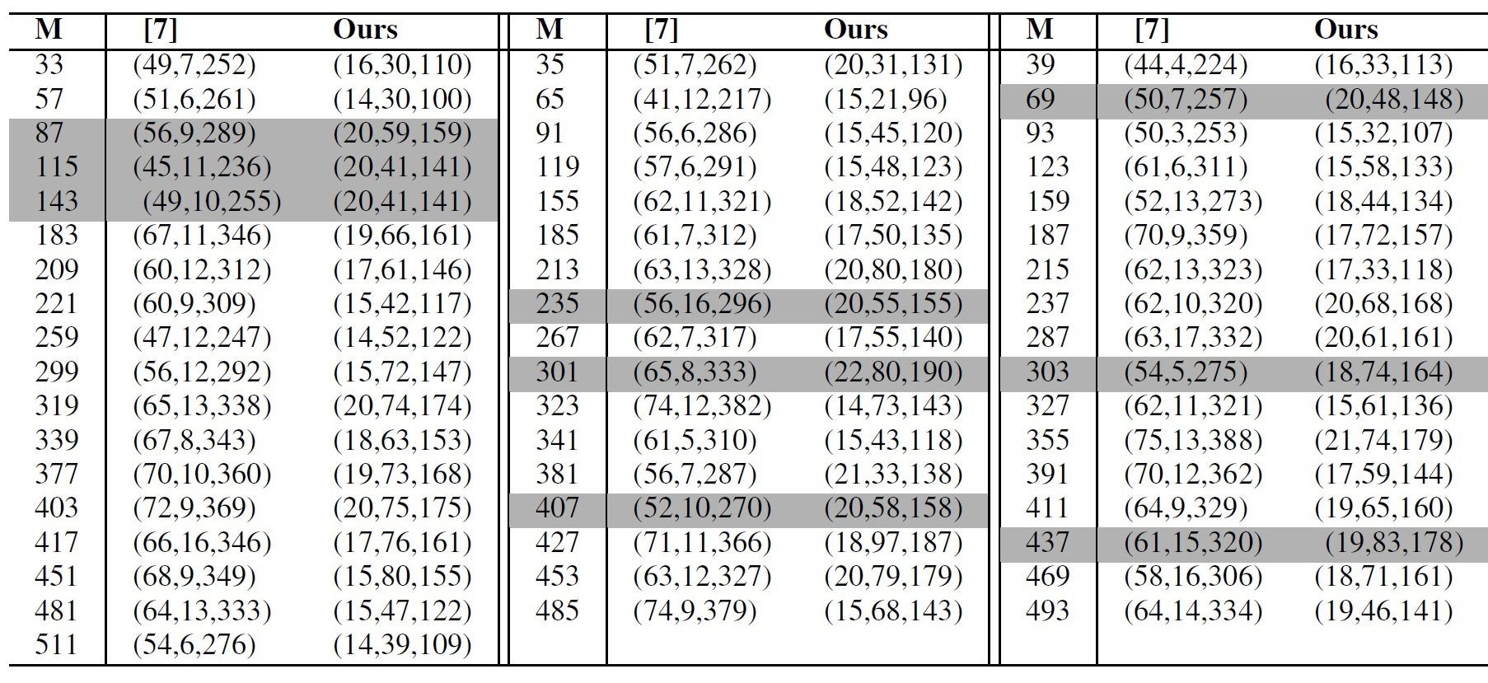
Results: Modular Exponentiation (1)
52% (on average ) improvement over [7, Table 8]
Runtime less than one minute in our method
(# of Toffoli, # of CNOT, cost)
[7] I. L. Markov and M. Saeedi, “Constant-optimized quantum circuits for modular multiplication and exponentiation,” QIC., vol. 12, no. 5-6, pp. 361–394, May 2012.
Notes:
For LUTs used in modular exponentiation, 52% improvement was obtained.

Slide 21
Results: Modular Exponentiation (2)
[7] I. L. Markov and M. Saeedi, “Constant-optimized quantum circuits for modular multiplication and exponentiation,” QIC., vol. 12, no. 5-6, pp. 361–394, May 2012.

Slide 22
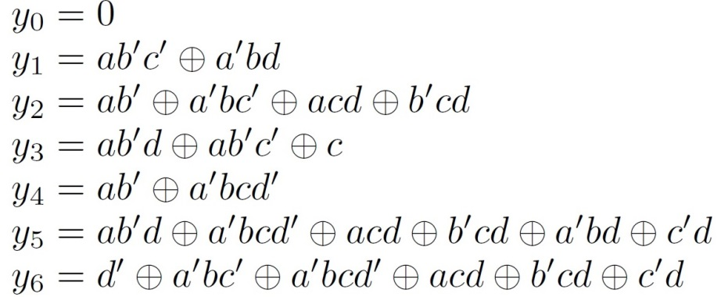
Sample Circuit
(4, 7)-LUT in modular exponentiation for M = 65
Can be removed by a post-synthesis optimization process
Notes:
And a sample circuit which is produced by our synthesis algorithm.

Slide 23
Conclusion
A synthesis algorithm for LUT’s by reversible gates
Cofactor Sharing
Un-computation
Look-ahead Search
Improvement of synthesis cost
52% on average in modular exponentiation algorithm
28% on average in the MCNC benchmarks

Slide 24
Thank you!

