Slide 1
FinCACTI: Architectural Analysis and Modeling of Caches with Deeply-scaled FinFET Devices
Alireza Shafaei, Yanzhi Wang,
Xue Lin, and Massoud Pedram
Department of Electrical Engineering
University of Southern California
http://atrak.usc.edu/

Slide 2
Outline
Introduction
FinFET Devices
Robust SRAM Cell Design
CACTI Cache Modeling Tool
FinCACTI (CACTI with FinFET support)
Technological Parameters
FinFET-based SRAM Cell Characteristics
Gate and Diffusion Capacitances
8T SRAM Cell Support
Simulation Results

Slide 3
Introduction
Memory design in deeply-scaled CMOS technologies
Increased short channel effects (SCE)
Higher sensitivity to device mismatches
Cache memories based on conventional 6T SRAM cell using planar CMOS devices may fail to function because of poor cell stability (read stability and write-ability)
Solutions to enhance the cell stability
Device-level
Use quasi-planar FinFET devices
Circuit-level
Introduce robust SRAM cell structures, e.g., 8T SRAM cells

Slide 4
FinFET Devices
Improved gate control (and lower impact of source and drain terminals) over the channel
Reduces SCE
Higher ON/OFF current ratio and improved energy efficiency
Superior physical scalability
Higher immunity to random variations and soft errors
Technology-of-choice beyond the 10nm CMOS node
FinFET geometries:
L_{FIN}: fin (gate) length
T_{SI}: fin width
H_{FIN}: fin height
W_{min}: effective channel width of a single fin (W_{min} ≈ 2 x H_{FIN})
FinFET-based SRAM cells

Slide 5
Robust SRAM Cells
Conventional 6T SRAM cell
Read stability: Pull down transistor must be stronger than the access transistor
Write-ability: Pull up transistor must be weaker than the access transistor
$$W_{M3}≤W_{M5}≤W_{M1}$$
Vulnerable especially in technology nodes below 16nm where process variations become a severe issue
8T SRAM cell
Decouples the storage node from the read bit-line
No constraint needed for read stability
Improved cell stability
Separate read path

Slide 6
Architecture-level Memory Modeling
CACTI, a widely-used delay, power, and area modeling tool for cache and memory systems
CACTI 6.5
N. Muralimanohar, R. Balasubramonian, and N. Jouppi, “Optimizing NUCA Organizations and Wiring Alternatives for Large Caches With CACTI 6.0,” MICRO-40, 2007.

Slide 7
CACTI Shortcomings for Future Memory Designs
Only supports planar CMOS devices for the following technology nodes
Metal pitch values: 90nm, 65nm, 45nm, 32nm, 22nm (with McPAT)
Inaccurate technological parameters
Extracted from ITRS documents (transistor and wire parameter values are predictions and best expert opinions from 2005 ITRS)
Only supports conventional 6T SRAM cell designs
A 6T SRAM cell design optimized for 130nm process is adopted for all technology nodes
The impact of V_{dd} scaling and device mismatches are ignored

Slide 8
Prior Work: CACTI-FinFET
Process variation models
The name is changed to CACTI-PVT later
Exact Quote: “For FinFETs in the deep submicron regime, satisfactory analytical models are still not available”
Lookup-tables used to store gate-level power/timing parameters
Our approach (FinCACTI)
Develop and use analytical models for calculating gate-level parameters from technology-dependent device-level characteristics
Easier to add new CMOS technologies or new devices
C.-Y. Lee and N. Jha, “CACTI-FinFET: An Integrated Delay and Power Modeling
Framework for FinFET-based Caches under Process Variations,” DAC, 2011.

Slide 9
FinCACTI
Accurate technological parameters for deeply-scaled (7nm) FinFET devices from Synopsys Technology Computer-Aided Design (TCAD) tool suite
ON/OFF currents of N- and P-type fins (for temperatures ranging from 300K to 400K)
SPICE-compatible Verilog-A models in order to derive gate- and circuit-level parameters (e.g., the PMOS to NMOS size ratio, and the stack effect factor), and to characterize FinFET-based SRAM cells (static noise margin, and leakage power)
Area and capacitance models for FinFET devices
Layout area, power, and access delay calculations for FinFET-based 6T and 8T SRAM cells
Architectural support for the 8T SRAM cell

Slide 10
Technological Parameters
CACTI 6.5
ITRS predictions
if (tech == 32)
{
SENSE_AMP_D = .03e-9; // s
SENSE_AMP_P = 2.16e-15; // J
//For 2013, MPU/ASIC stagger-contacted M1 half-pitch is 32 nm (so this is 32 nm
//technology i.e. FEATURESIZE = 0.032). Using the SOI process numbers for
//HP and LSTP.
vdd[0] = 0.9;
Lphy[0] = 0.013;
Lelec[0] = 0.01013;
t_ox[0] = 0.5e-3;
v_th[0] = 0.21835;
c_ox[0] = 4.11e-14;
mobility_eff[0] = 361.84 * (1e-2 * 1e6 * 1e-2 * 1e6);
Vdsat[0] = 5.09E-2;
c_g_ideal[0] = 5.34e-16;
c_fringe[0] = 0.04e-15;
c_junc[0] = 1e-15;
I_on_n[0] = 2211.7e-6;
I_on_p[0] = I_on_n[0] / 2;
nmos_effective_resistance_multiplier = 1.49;
n_to_p_eff_curr_drv_ratio[0] = 2.41;
gmp_to_gmn_multiplier[0] = 1.38;
Rnchannelon[0] = nmos_effective_resistance_multiplier * vdd[0] / I_on_n[0];
Rpchannelon[0] = n_to_p_eff_curr_drv_ratio[0] * Rnchannelon[0];
I_off_n[0][0] = 1.52e-7;
…
I_off_n[0][100] = 6.1e-6;
…
}

Slide 11
Technological Parameters (cont’d)
FinCACTI
Device-level parameters obtained by Synopsys TCAD Tool Suite
Gate- and circuit-level parameters from Verilog-A-based SPICE simulations
7nm FinFET
Parameter | Value | Comment
V_{dd} (V) | 0.45 | Supply voltage
V_{th} (V) | 0.235 | Threshold voltage
I_{ON,NMOS} (A/µm) | 8.82e-04 | ON current of a N-type FinFET
I_{ON,PMOS} (A/µm) | 5.50e-04 | ON current of a P-type FinFET
I_{OFF,NMOS} (A/µm) | 7.62e-08 | OFF current of a N-type FinFET
I_{OFF,PMOS} (A/µm) | 1.16e-07 | OFF current of a P-type FinFET
L_{phy} (nm) | 7 | Physical gate length
C_{g,ideal} (A/µm) | 1.59e-16 | Ideal gate capacitance
PMOS to NMOS size ratio | 1.6
NAND2 stack effect factor | 0.4 | Stack effect of two N-type FinFETs
NAND3 stack effect factor | 0.2 | Stack effect of three N-type FinFETs
NOR2 stack effect factor | 0.4 | Stack effect of two P-type FinFETs
Param. Name | Param. Symbol | Value (nm)
Min Gate Length | L_{FIN} | 7
Fin Width | T_{SI} | 3.5
Fin Height | H_{FIN} | 14
Fin Pitch | P_{FIN} | 10.5
Oxide Thickness | T_{ox} | 1.55

Slide 12
FinFET Layout: Single vs. Multiple Fins
P_{FIN}: fin pitch, or the minimum center-to-center distance between two adjacent parallel fins—Depends on the underlying FinFET technology.
N_{FIN}: number of fins—For a FinFET with channel width of W,
$$N_{FIN}= \left\lceil W/{W_{min}}\right\rceil$$

Slide 13
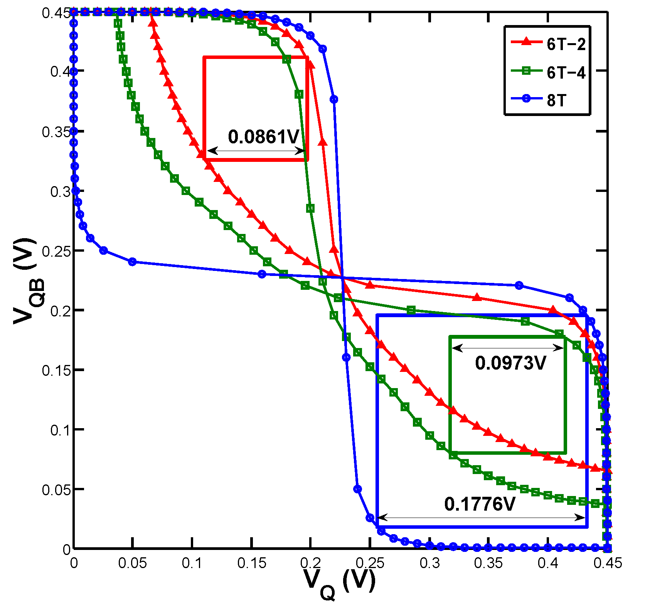
SRAM Cell Characteristics (SNM)
6T-n: a 6T SRAM cell whose pull-down transistors have n fins each
6T-1 SRAM cell does not work properly in the 7nm technology because of too weak a pull down transistor
Cell | SNM (V)
6T-2 | 0.0861
6T-3 | 0.0925
6T-4 | 0.0973
8T | 0.1776
Butterfly curves: common graphical representation of SNM
SNM: Static Noise Margin

Slide 14
SRAM Cell Characteristics (Layout Area)
Assuming very conservative design rules:
Cell | Area (nm²)
6T-1 | 6,615
6T-2 | 7,938
6T-3 | 9,261
6T-4 | 10,584
8T | 9,261
Y-span = 2L_{FIN} + 14λ
X-span_{6T-n} = 2(n-1)P_{FIN} + 30λ
X-span_{8T} = 42λ

Slide 15
SRAM Cell Characteristics (Leakage Power)
During the standby mode:
BL and BLB (or WBL and WBLB) are pre-charged to V_{DD}
RBL is pre-discharged to 0, and
All word-lines are deactivated
Cell | P_{leak} (nW)
6T-1 | 0.67
6T-2 | 1.58
6T-4 | 1.92
8T | 1.32

Slide 16
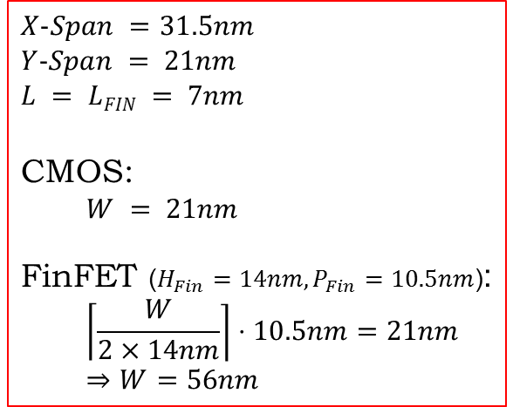
Transistor Area
Layouts of a transistor with channel width of W in planar CMOS and FinFET process technologies:
Channel width under the same layout footprint
Planar CMOS
FinFET
$$X−Span =31.5nm$$
$$Y−Span = 21nm$$
$$L = LFIN = 7nm$$
CMOS:
$$W = 21nm$$
FinFET ($H_{Fin}=14nm, P_{Fin}=10.5nm$):
$$\left\lceil \frac{W}{2×14nm}\right\rceil ⋅10.5nm=21nm$$
$$⇒W=56nm$$
Transistor’s X-span is determined by contact-related design rules (similar for planar CMOS and FinFET) and the channel length (L).

Slide 17
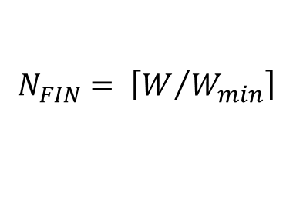
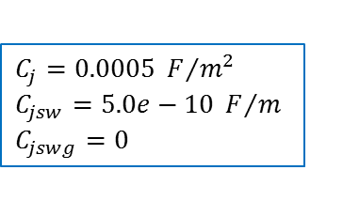
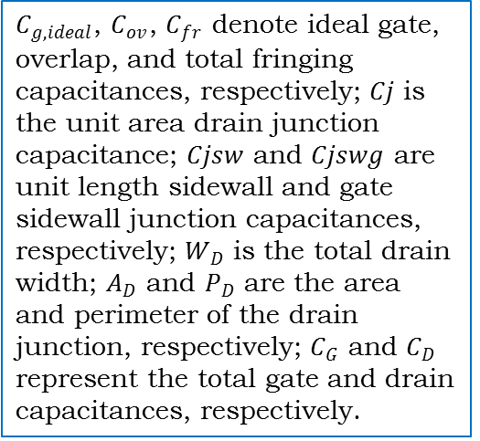
Gate and Diffusion Capacitances
Width quantization property of FinFET devices
FinFET width can only take discrete values
The effective channel width ($W_{CH}$) may become larger than the required width (i.e., an over-sized transistor)
$$N_{FIN}= \left\lceil W/{W_{min}}\right\rceil$$
$C_{g,ideal}$, $C_{ov}$, $C_{fr}$ denote ideal gate, overlap, and total fringing capacitances, respectively; $Cj$ is the unit area drain junction capacitance; $Cjsw$ and $Cjswg$ are unit length sidewall and gate sidewall junction capacitances, respectively; $W_{D}$ is the total drain width; $A_{D}$ and $P_{D}$ are the area and perimeter of the drain junction, respectively; $C_{G}$ and $C_{D}$ represent the total gate and drain capacitances, respectively.
$$W_{CH}= N_{FIN}⋅W_{min}$$
$$C_{G}\left(N_{FIN}\right)= \left(C_{g,ideal}+C_{ov}+C_{fr}\right){⋅W}_{CH}$$
$$C_{D}\left(N_{FIN}\right)= C_{j}⋅A_{D}+C_{jsw}⋅P_{D}+C_{jswg}⋅W_{CH}$$
$$A_{D}= \left(W_{D}⋅T_{SI}\right){⋅N}_{FIN}$$
$$P_{D}=2⋅\left(W_{D}+T_{SI}\right){⋅N}_{FIN}$$
$$C_{j}=0.0005 F/{m^{2}}$$
$$C_{jsw}=5.0e−10 F/m$$
$$C_{jswg}=0$$
BSIM-CMG 107.0.0

Slide 18
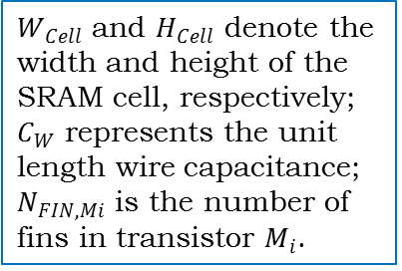
8T SRAM Cell
Modified row decoder
Capacitances of read and write WLs, and read and write BLs for a sub-array with n rows and m columns:
$$C_{RWL}=m⋅\left(C_{G}\left(N_{FIN,M8}\right)+W_{Cell}⋅C_{W}\right)$$
$W_{Cell}$ and $H_{Cell}$ denote the width and height of the SRAM cell, respectively; $C_{W}$ represents the unit length wire capacitance; $N_{FIN,Mi}$ is the number of fins in transistor $M_{i}$.
$$C_{WWL}=m⋅\left({2⋅C}_{G}\left(N_{FIN,M5}\right)+W_{Cell}⋅C_{W}\right)$$
$$C_{RBL}=n⋅\left(C_{D}\left(N_{FIN,M8}\right)/2+H_{Cell}⋅C_{W}\right)$$
$$C_{WBL}=n⋅\left(C_{D}\left(N_{FIN,M5}\right)/2+H_{Cell}⋅C_{W}\right)$$
Notes:
The drain capacitance of each access transistor (M5, M6, and M8) is divided by two since each contact is shared between two vertically adjacent cells.

Slide 19
Simulation Setup
For all simulations a 4MB, 8-way, set-associative L3 cache with the following configurations is assumed:
Technological parameters of 32nm (and 22nm) (½ metal pitch) planar CMOS process are extracted (from McPAT).
Results of 6T-1 cell under 7nm (gate length) FinFET are reported for comparison purposes.
Parameter | Value | Parameter | Value
Cache size | 4MB | Device type | HP
Block size | 64B | Associativity | 8
Read/write ports | 1 | Bus width | 512
Cache model | Uniform Cache Access | Number of banks | 4
Temperature | 330K | Objective | Energy-Delay Product
32nm: Vdd = 0.90V
22nm: Vdd = 0.80V
7nm: Vdd = 0.45V

Slide 20
Simulation Results (1)
Feature size scaling
Smaller footprint of FinFETs
V_{dd} scaling
Lower OFF current of FinFETs

Slide 21
Simulation Results (2)
Capacitance scaling
Higher ON current of FinFETs
Smaller SRAM footprint in FinFETs
V_{dd} scaling (for energy)

Slide 22
Simulation Results (3)
 | Access Time (ns) | Read Energy (nJ) | Leakage Power (mW) | Cache Area (mm2)
32nm CMOS | 2.084 | 0.790 | 47.582 | 19.590
22nm CMOS | 1.744 | 0.447 | 59.829 | 9.240
16nm CMOS | 1.459 | 0.253 | 75.227 | 4.358
10nm CMOS | 1.221 | 0.143 | 94.588 | 2.056
7nm CMOS | 1.021 | 0.081 | 118.932 | 0.970
7nm FinFET | 0.569 | 0.048 | 19.873 | 0.826
Scaling Factor | 0.84 | 0.57 | 1.26 | 0.47
8T SRAM Cell
 | Access Time (ns) | Read Energy (nJ) | Leakage Power (mW) | Cache Area (mm2)
32nm CMOS | 1.397 | 0.493 | 59.199 | 15.545
22nm CMOS | 1.164 | 0.278 | 76.135 | 7.345
16nm CMOS | 0.970 | 0.157 | 97.917 | 3.470
10nm CMOS | 0.809 | 0.089 | 125.930 | 1.640
7nm CMOS | 0.674 | 0.050 | 161.957 | 0.775
7nm FinFET | 0.498 | 0.043 | 23.187 | 0.714
Scaling Factor | 0.83 | 0.56 | 1.29 | 0.47
6T SRAM Cell
6T-2

Slide 23
Future Work
XML interfaces for
Technological parameters
SRAM cell configuration
Dual-Vdd support
Super- and near-threshold regimes
ON/OFF currents, and sense-amplifier characteristics for near-threshold regime
Dual-gate controlled SRAM cells
SRAM cell layout area, ON/OFF currents of dual-gate FinFETs
14nm planar CMOS designed using TCAD tools
Updated wire parameters
Technical report and a web interface for FinCACTI

