Slide 1


A Cross-Layer Framework for Designing and Optimizing
Deeply-Scaled FinFET-Based
SRAM Cells under Process Variations
Alireza Shafaei, Shuang Chen,
Yanzhi Wang, and Massoud Pedram
http://sportlab.usc.edu/

Slide 2
Outline
Introduction
FinFET Devices
Dual-gate Controlled SRAM Cells
Robust SRAM Cell Design under Process Variations
  Process Variations in FinFET Technology
  Optimization Framework
Simulation Results

Slide 3
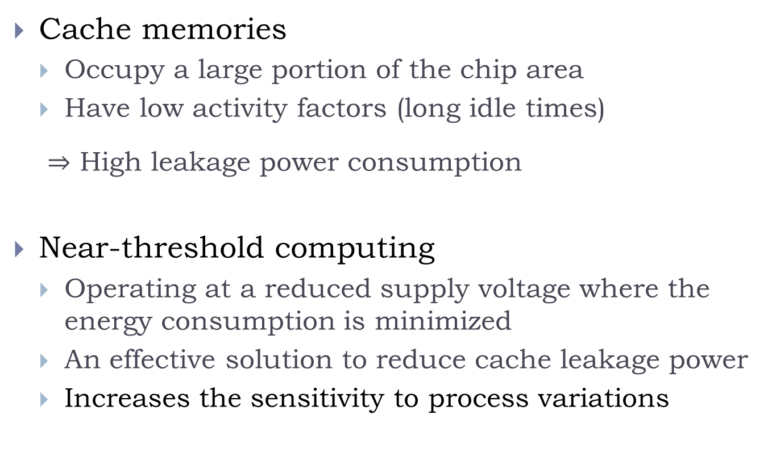
Introduction
Cache memories
  Occupy a large portion of the chip area
  Have low activity factors (long idle times)
  $⇒$ High leakage power consumption
Near-threshold computing
  Operating at a reduced supply voltage where the energy consumption is minimized
  An effective solution to reduce cache leakage power
  Increases the sensitivity to process variations

Slide 4
Introduction (cont’d)
Cache memories
  Need SRAM cells with small footprint in order to improve memory density
    Minimum-size transistors
  Increases the sensitivity to process variations
Deeply-scaled (sub-10nm) technology nodes
  Extremely small geometries
  Reduced supply voltage levels
  Increases the sensitivity to process variations
Robust SRAM cell designs are vital

Slide 5
Robust SRAM Cells
Solutions to enhance the cell stability
  Circuit solutions
    Various Read and Write assist circuit techniques
      Outside the scope of this presentation
    Adopt robust SRAM cell structures, e.g., 8T SRAM cells
      Side effect: area overhead → longer access latency, and higher access energy
  FinFET-specific solutions
    Dual-gate control of FinFET devices
      It is important to be able to use this method without requiring any external signal to drive the back gate of FinFET devices

Slide 6
Key Benefits of FinFET Devices
Improved gate control (and lower influence of the source and drain terminals) over the channel
  Reduces short channel effects
Improved ON/OFF current ratio and reduced leakage
Improved voltage scalability
Reduced variability due to the absence of channel doping
Reduced Drain Induced Barrier Lowering (DIBL) effect and substrate biasing

Slide 7
Dual-gate control Feature of FinFETs
Dual-gate control
  Front gate (FG) controls the on/off state
  Back gate (BG) adjusts the threshold voltage
By connecting the back gate of an N-type (P-type) FinFET to a low (high) voltage such as Gnd (V_{DD}), the threshold voltage will increase when the front gate is turned on
Gate oxide
Notes:
Independent (dual) gate control:
Dynamic solutions for managing the delay/power trade-off of circuit designs
Improving the read and write margins of SRAM cells

Slide 8
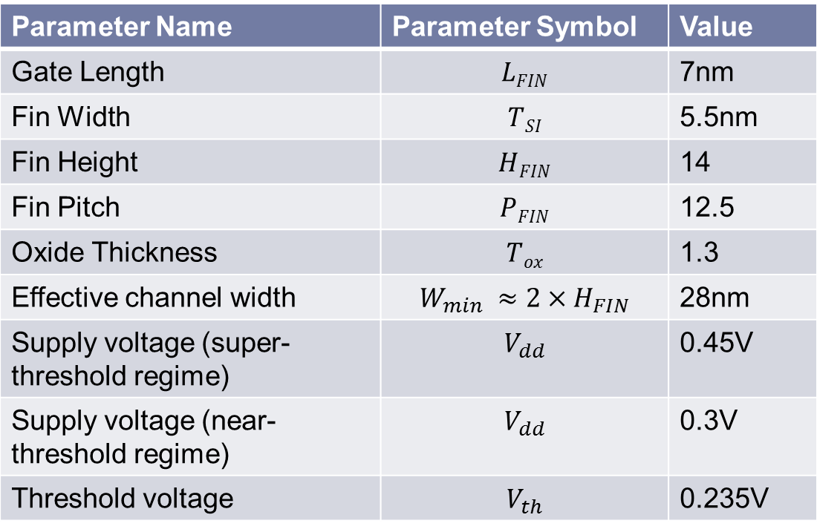
7nm Dual-gate FinFET Devices
FinFET devices with actual gate length of 7nm have been designed and characterized
  See http://sportlab.usc.edu/downloads/
Parameter Name | Parameter Symbol | Value
Gate Length | $$LFIN$$ | 7nm
Fin Width | $$TSI$$ | 5.5nm
Fin Height | $$HFIN$$ | 14
Fin Pitch | $$PFIN$$ | 12.5
Oxide Thickness | $$Tox$$ | 1.3
Effective channel width | $$W_{min} ≈2×H_{FIN}$$ | 28nm
Supply voltage (super-threshold regime) | $$V_{dd}$$ | 0.45V
Supply voltage (near-threshold regime) | $$V_{dd}$$ | 0.3V
Threshold voltage | $$V_{th}$$ | 0.235V

Slide 9
Dual-gate Controlled SRAM Cells
Only uses signals internal to the SRAM cell for back gate connections
  Write-ability is achieved by weakening the P-type pull-up transistors
  Read stability is achieved by weakening the access transistor during read operation
Dual-gate controlled 6T SRAM cell
Dual-gate controlled 8T SRAM cell

Slide 10
Layouts
With careful design, layout of FinFET SRAM cells using dual-gate control does not cause any area increase.
6T-SG
8T-SG
6T-DG
8T-DG

Slide 11
Comparison of SRAM Cells
SG: SRAM cell with all FinFETs in the single-gate mode (i.e., front and back gates are connected together).
DG: dual-gate controlled SRAM cell.
6Tn: 6T SRAM cell whose pull-down transistors have n fins each.
6T1 cell does not work properly in our 7nm FinFET process (because of weak pull-downs).
SNM: Static Noise Margin

Slide 12
Outline
Introduction
FinFET Devices
Dual-gate Controlled SRAM Cells
Robust SRAM Cell Design under Process Variations
  Process Variations in FinFET Technology
  Optimization Framework
Simulation Results

Slide 13
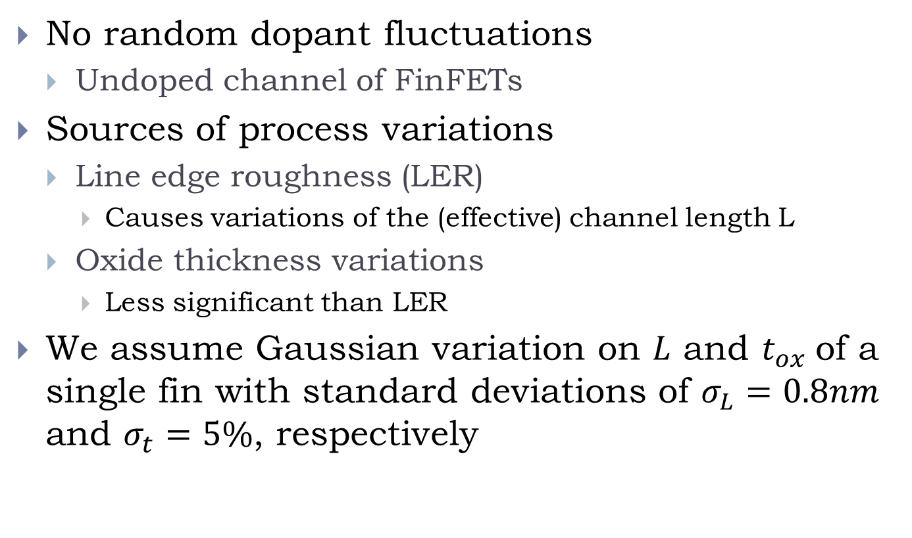
Process Variations in FinFETs
No random dopant fluctuations
  Undoped channel of FinFETs
Sources of process variations
  Line edge roughness (LER)
    Causes variations of the (effective) channel length L
  Oxide thickness variations
    Less significant than LER
We assume Gaussian variation on $L$ and $t_{ox}$of a single fin with standard deviations of $σ_{L}=0.8nm$ and $σ_{t}=5\%$, respectively

Slide 14
Process Variations in FinFETs (cont’d)
The effect of process variations is more significant in subthreshold regime
  ON current is (approximately) exponentially dependent on the threshold voltage and/or subthreshold slope, which is affected by LER
The effect of process variations is more significant on OFF current

Slide 15
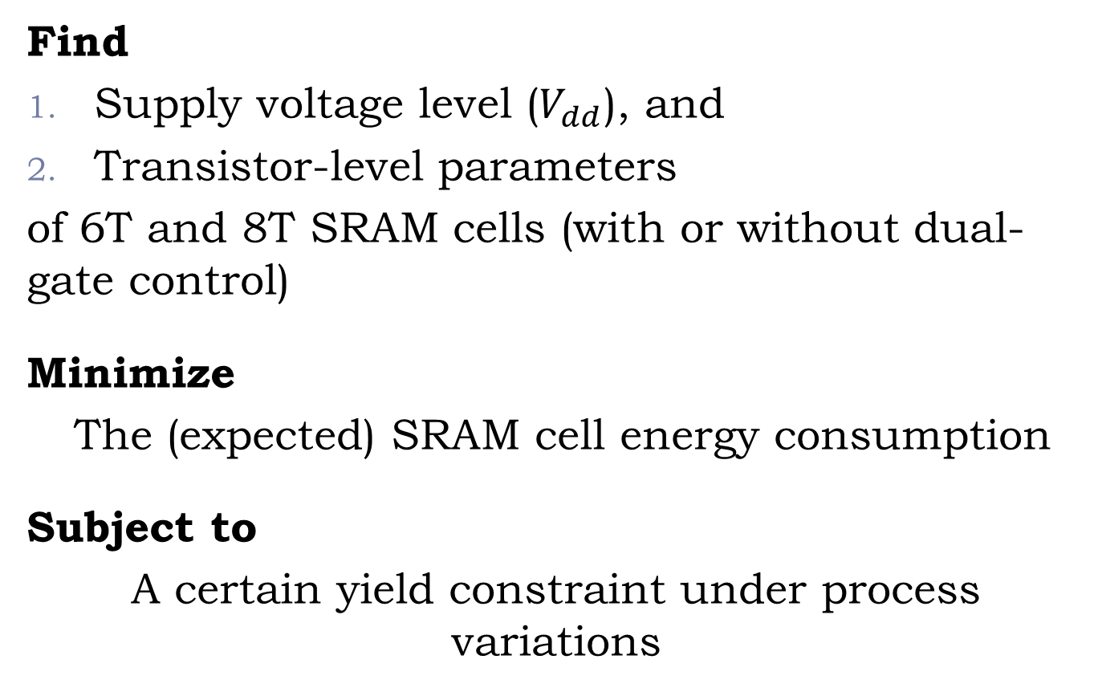
Optimization Problem
Find
Supply voltage level ($V_{dd}$), and
Transistor-level parameters
of 6T and 8T SRAM cells (with or without dual-gate control)
Minimize
The (expected) SRAM cell energy consumption
Subject to
A certain yield constraint under process variations

Slide 16
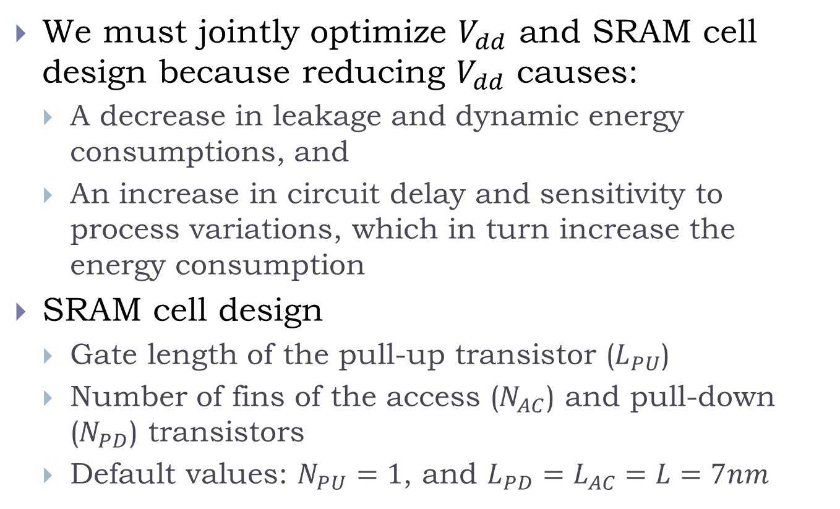
Motivation of Joint Optimization
We must jointly optimize $V_{dd}$ and SRAM cell design because reducing $V_{dd}$ causes:
  A decrease in leakage and dynamic energy consumptions, and
  An increase in circuit delay and sensitivity to process variations, which in turn increase the energy consumption
SRAM cell design
  Gate length of the pull-up transistor ($L_{PU}$)
  Number of fins of the access ($N_{AC}$) and pull-down ($N_{PD}$) transistors
  Default values: $N_{PU}=1$, and $L_{PD}=L_{AC}=L=7nm$

Slide 17
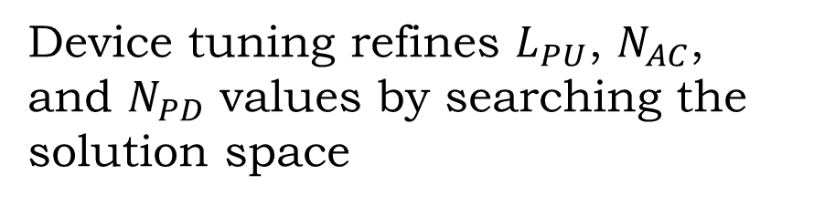
Design Flow
WCA: worst-case analysis problem
WCA finds the optimal SRAM cell design for the worst-case corner of process variation
WCA’s solution is overly pessimistic, and hence is refined later in the device tuning step
Device tuning refines $L_{PU}$, $N_{AC}$, and $N_{PD}$ values by searching the solution space

Slide 18
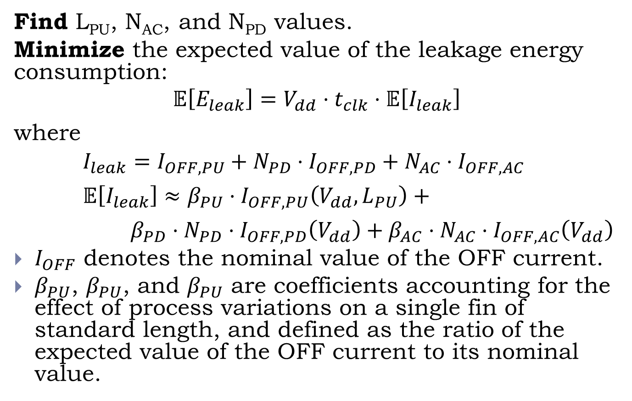
WCA Problem (1)
Find L_{PU}, N_{AC}, and N_{PD} values.
Minimize the expected value of the leakage energy consumption:
$$𝔼\left[E_{leak}\right]=V_{dd}⋅t_{clk}⋅𝔼\left[I_{leak}\right]$$
where
$I_{leak}=I_{OFF,PU}+{N_{PD}⋅I}_{OFF,PD}+{N_{AC}⋅I}_{OFF,AC}$
$𝔼\left[I_{leak}\right]≈{β_{PU}⋅I}_{OFF,PU}\left(V_{dd},L_{PU}\right)\text{ +}$
${β_{PD}⋅N_{PD}⋅I}_{OFF,PD}\left(V_{dd}\right)+$ ${β_{AC}⋅N_{AC}⋅I}_{OFF,AC}\left(V_{dd}\right)$
$I_{OFF}$ denotes the nominal value of the OFF current.
$β_{PU}$, $β_{PU}$, and $β_{PU}$ are coefficients accounting for the effect of process variations on a single fin of standard length, and defined as the ratio of the expected value of the OFF current to its nominal value.
18

Slide 19
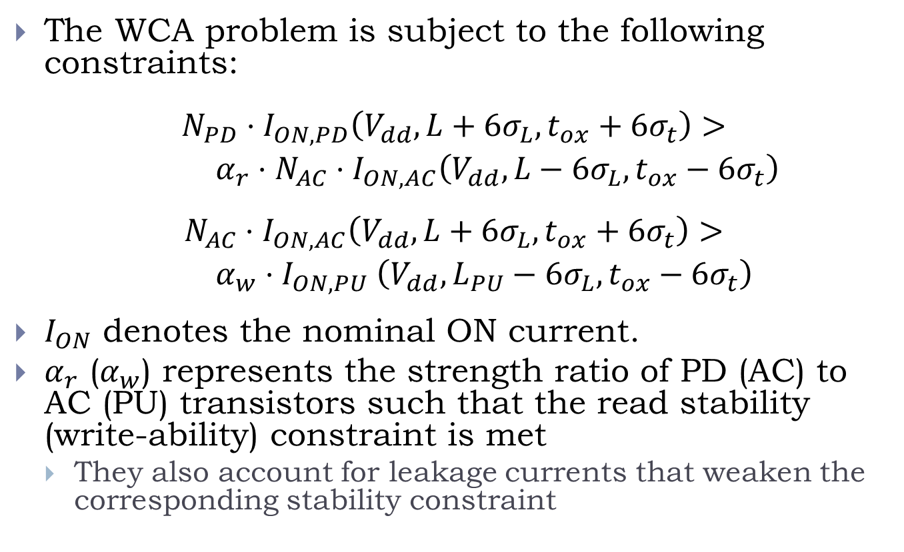
WCA Problem (2)
The WCA problem is subject to the following constraints:
$${N_{PD}⋅I}_{ON,PD}\left(V_{dd},L+6σ_{L},t_{ox}+6σ_{t}\right)>$$
$α_{r}⋅{N_{AC}⋅I}_{ON,AC}\left(V_{dd},L−6σ_{L},t_{ox}−6σ_{t}\right)$
$${N_{AC}⋅I}_{ON,AC}\left(V_{dd},L+6σ_{L},t_{ox}+6σ_{t}\right)>$$
$α_{w}{⋅I}_{ON,PU}\left(V_{dd},L_{PU}−6σ_{L},t_{ox}−6σ_{t}\right)$
$I_{ON}$ denotes the nominal ON current.
$α_{r}$ ($α_{w}$) represents the strength ratio of PD (AC) to AC (PU) transistors such that the read stability (write-ability) constraint is met
  They also account for leakage currents that weaken the corresponding stability constraint
Read stability
Write-ability

Slide 20
Device Tuning
AYA: Analytical Yield Analysis problem

Slide 21
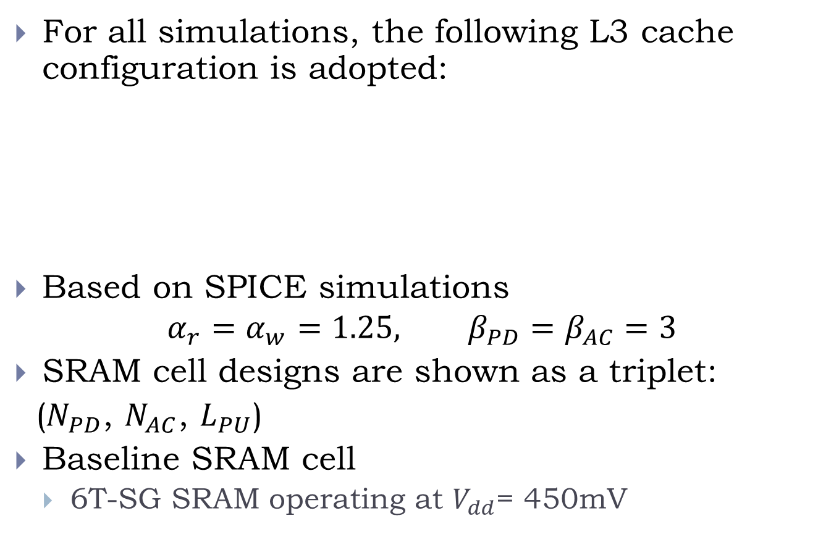
Simulation Setup
For all simulations, the following L3 cache configuration is adopted:
Based on SPICE simulations
$$α_{r}=α_{w}=1.25, β_{PD}=β_{AC}=3$$
SRAM cell designs are shown as a triplet:
($N_{PD}$, $N_{AC}$, $L_{PU}$)
Baseline SRAM cell
  6T-SG SRAM operating at $V_{dd}$= 450mV
Parameter | Value | Parameter | Value
Cache size | 4MB | Associativity | 8
Block size | 64B | Number of banks | 4
Read/write ports | 1 | Bus width | 512

Slide 22
Simulation Results: Cell-Level
Best result: (1,1,10) 6T SRAM cell equipped with the proposed dual-gate control scheme, operating at 324mV
For the 8T SRAM cell, due to relaxing the read stability constraint, we can find a valid solution even under very low operating voltages
The main drawback of 8T compared with 6T is the larger area, which increases the wordline and bitline capacitances

Slide 23
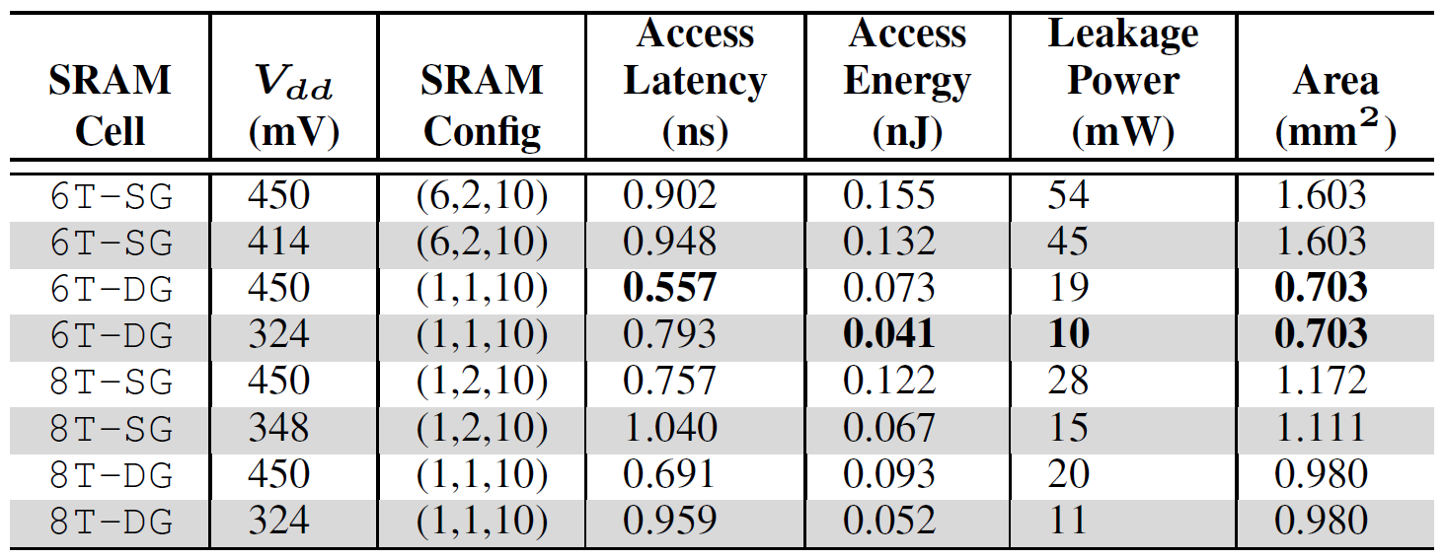
Simulation Results: Architecture-Level
Based on P-CACTI tool
http://sportlab.usc.edu/download/pcacti/
Leakage power of the optimal SRAM cell is reduced by a factor of 5.4X compared to the baseline SRAM cell
Baseline SRAM
Optimal SRAM

Slide 24
Summary
In our 7nm FinFET process, the dual-gate controlled 6T SRAM cell, operating at 324mV (in the near-threshold supply regime), achieves the lowest expected leakage energy consumption under process variations.

